Slide 1
Design of an IoT-enabled Scalable Closed Hydroponics System with Smart Parameter Control
Supervised by:
Dr. Lafifa Jamal Professor Department of Robotics and Mechatronics Engineering University of Dhaka
Proposed by: Mikdam-Al-Maad Ronoue Class Roll: FH-092-003 MD. Sameer Iqbal Chowdhury Class Roll: SH-092-002

Slide 2
Methodology

Slide 3
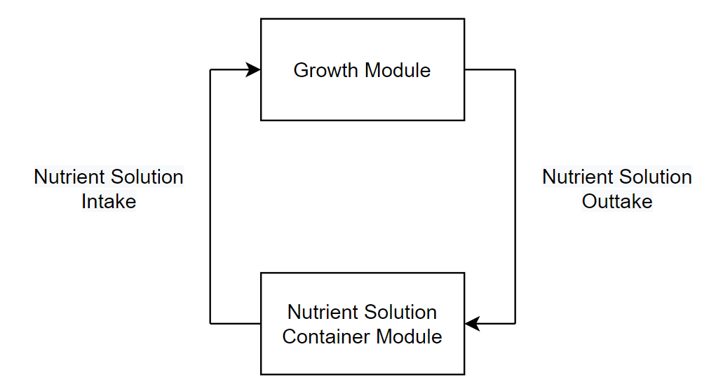
Overview
Fig. 1: Simplified outline of the system illustrating the flow of nutrient solution

Slide 4

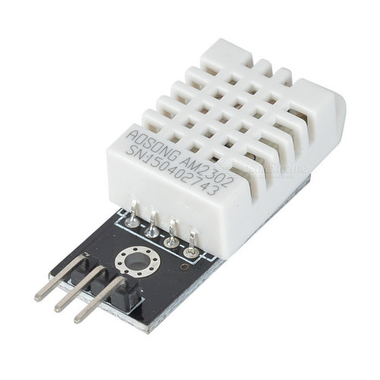
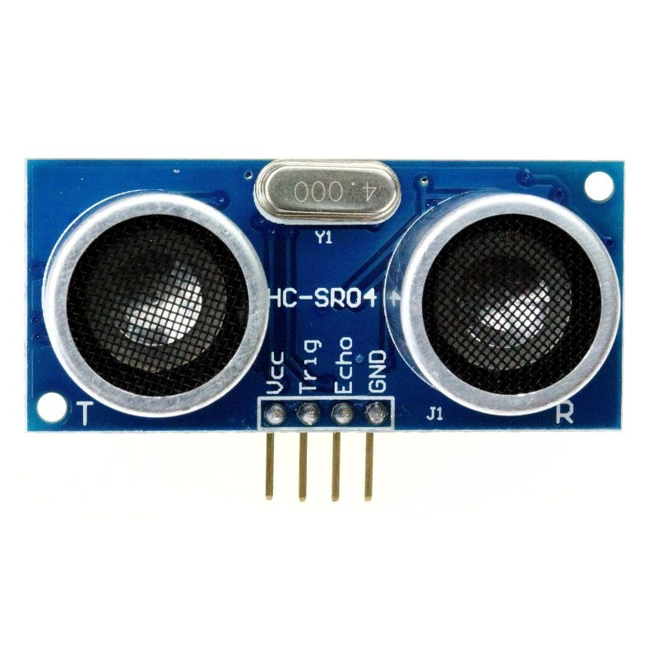
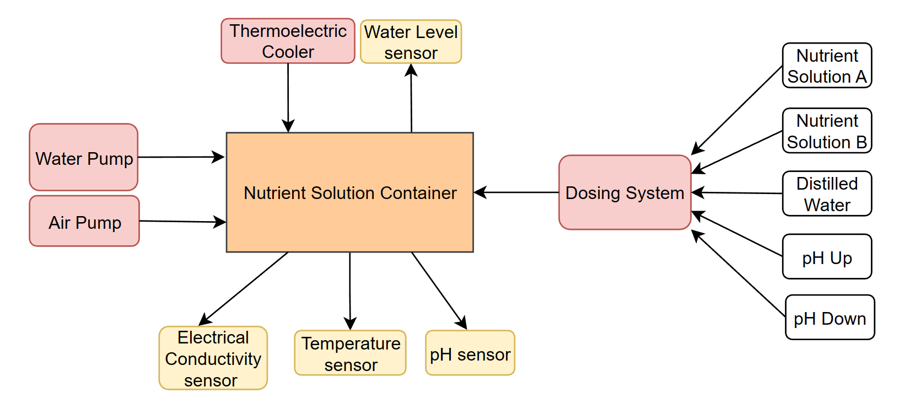
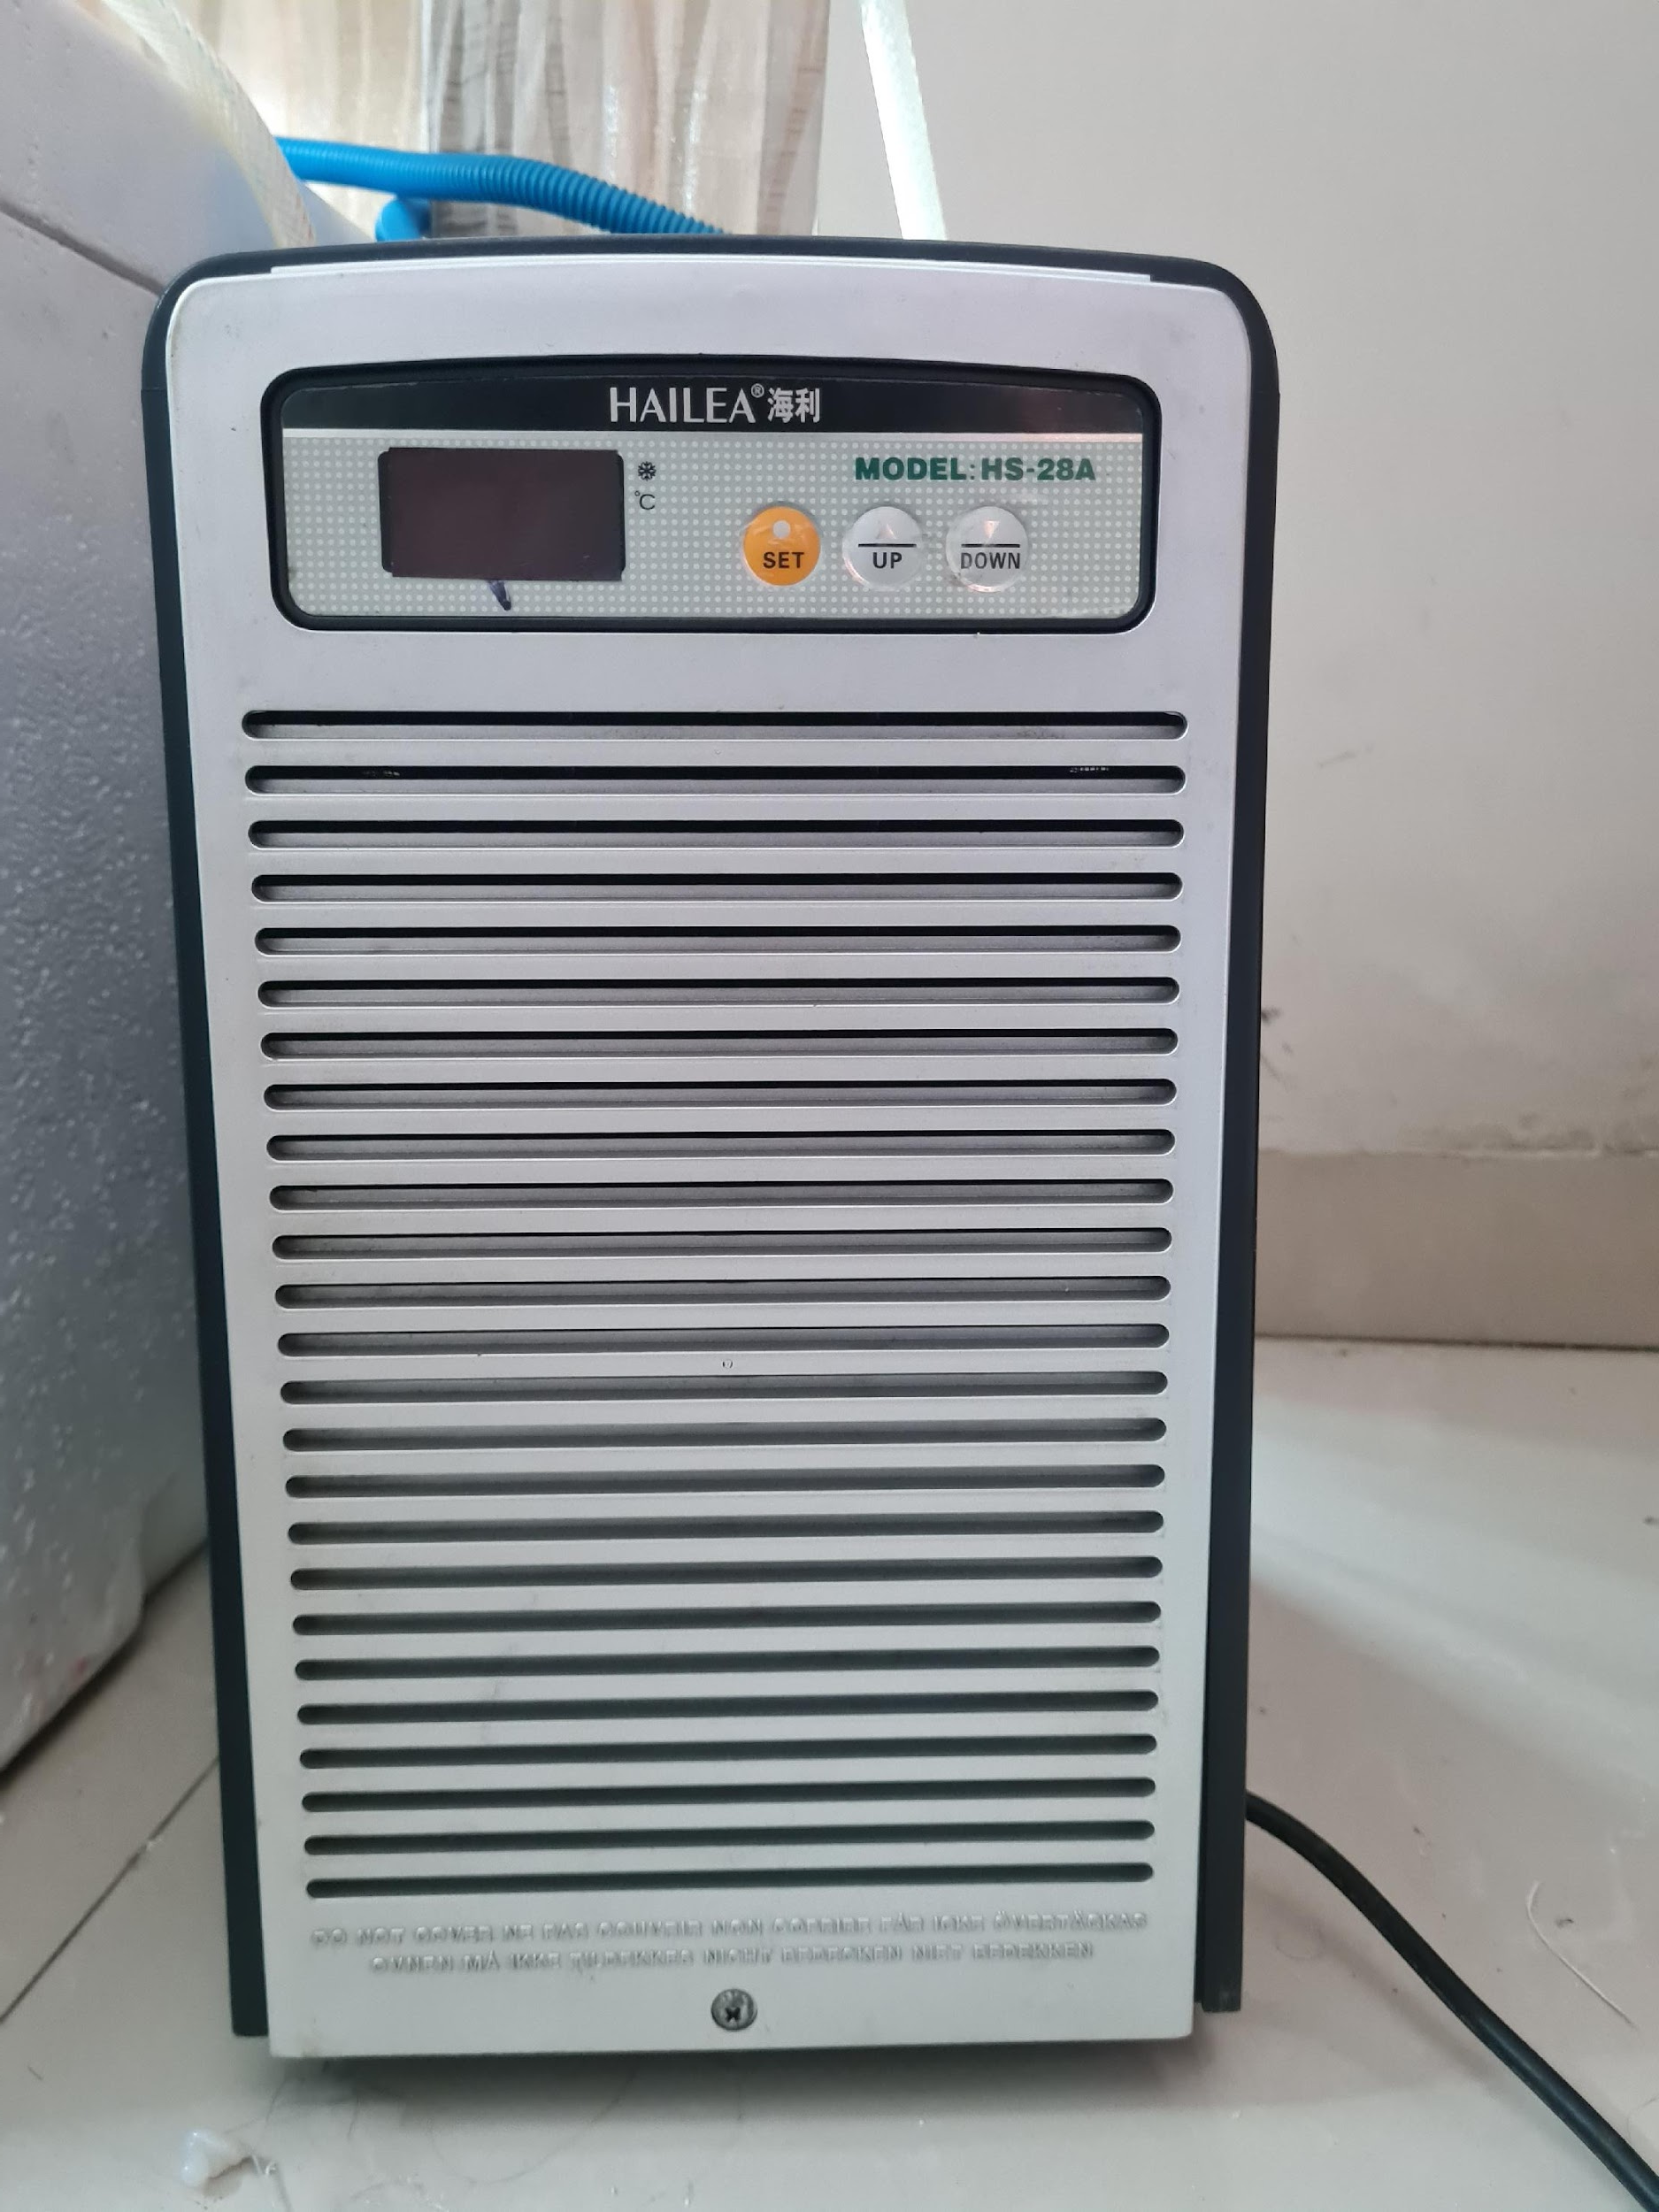
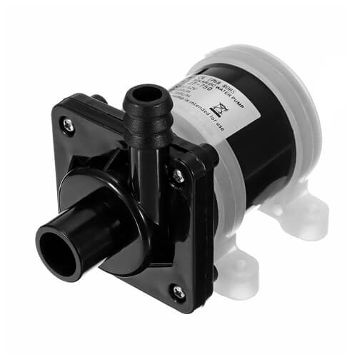
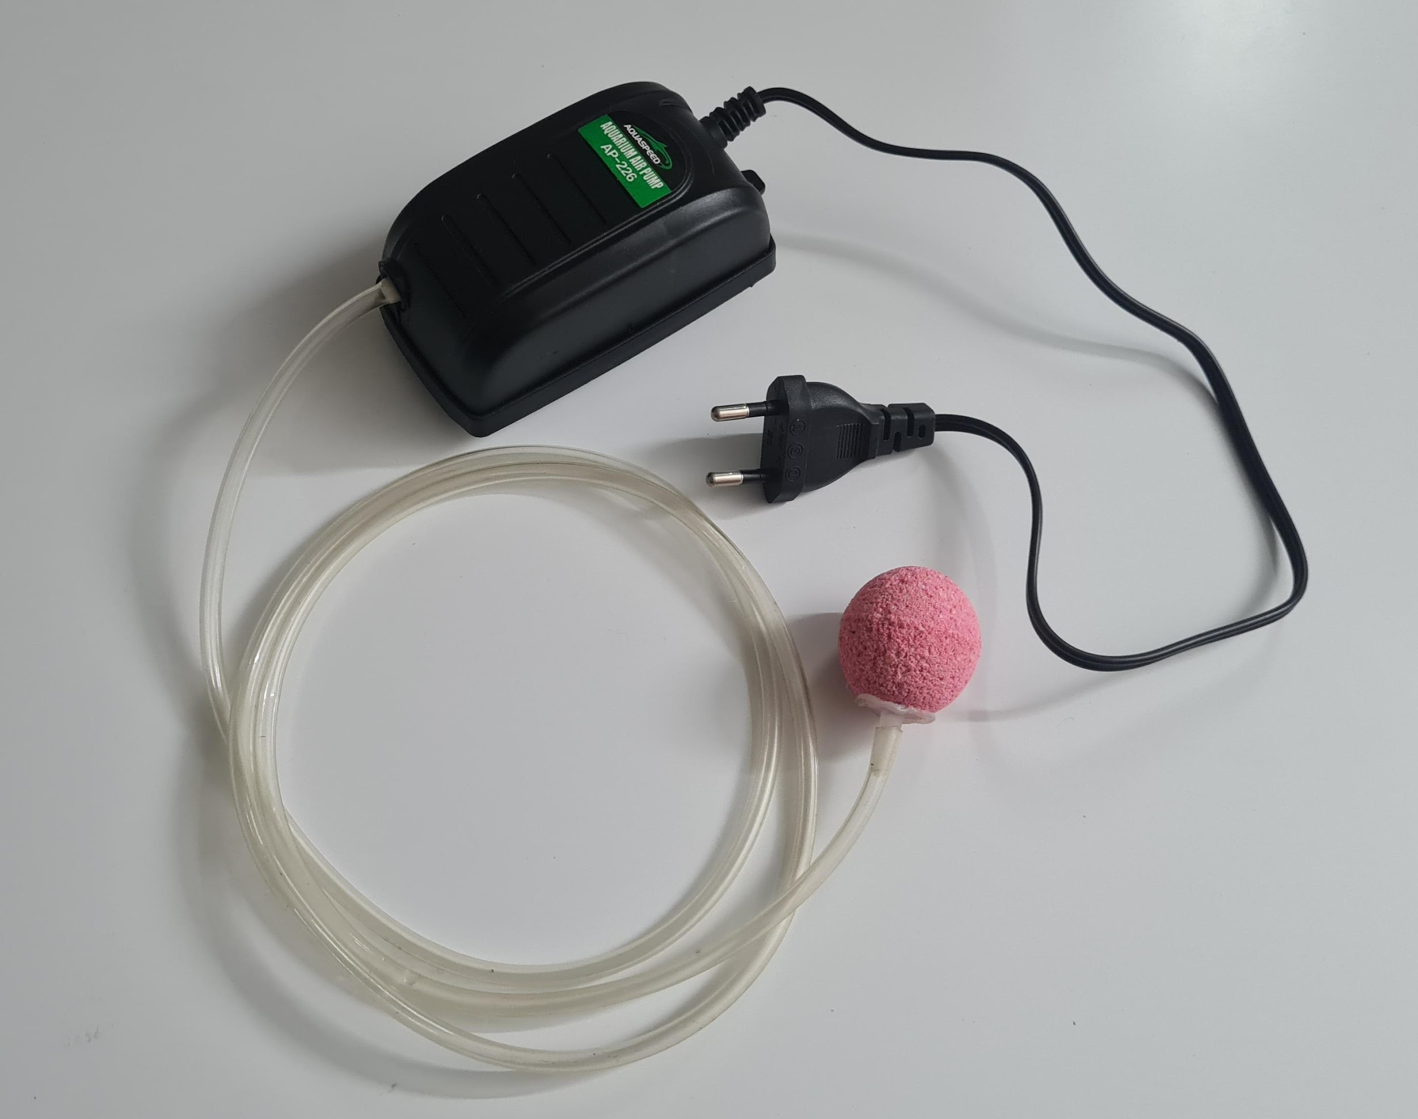
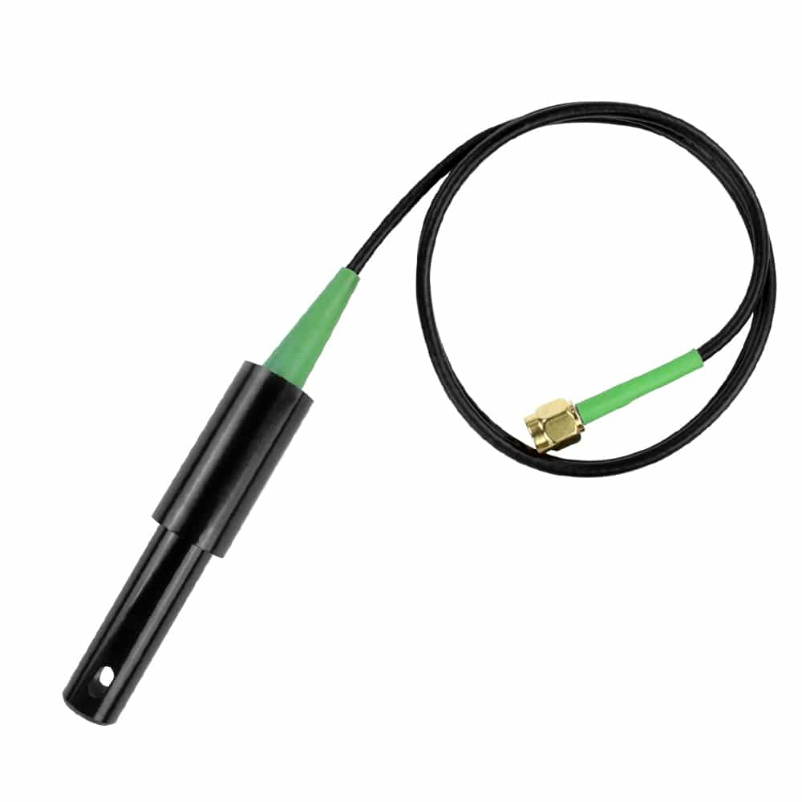
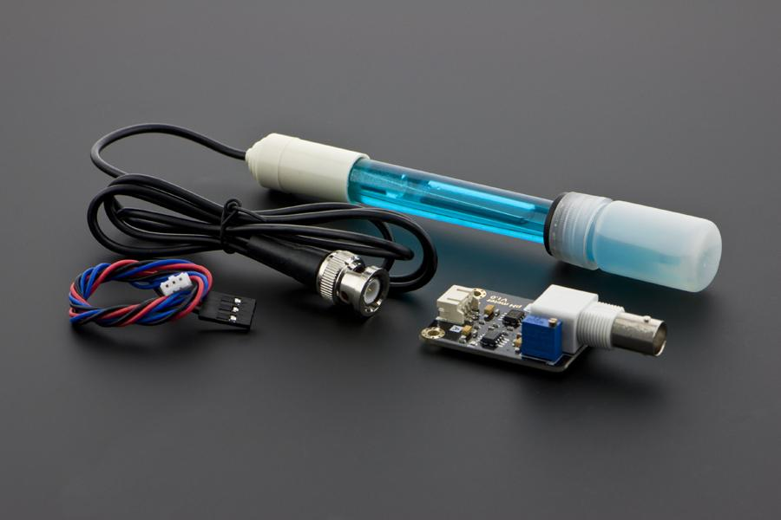
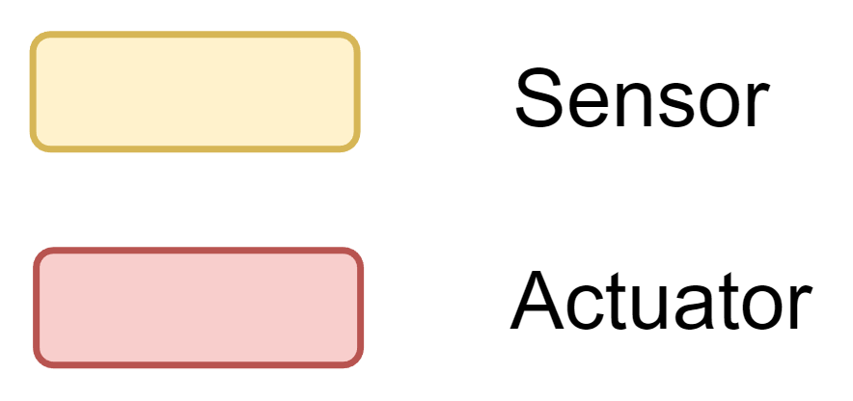
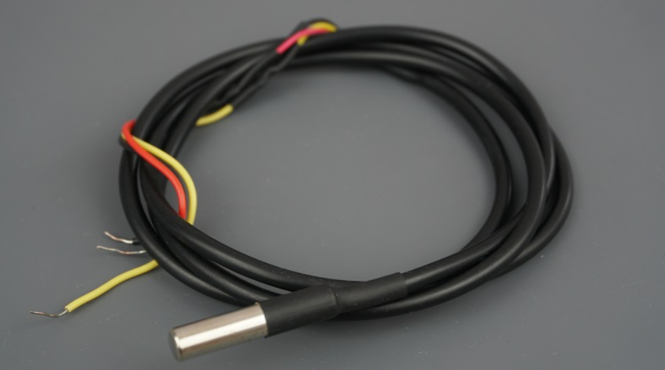
Nutrient Solution Container Module
Fig. 2: Block diagram for communication between microcontrollers and the central server

Slide 5
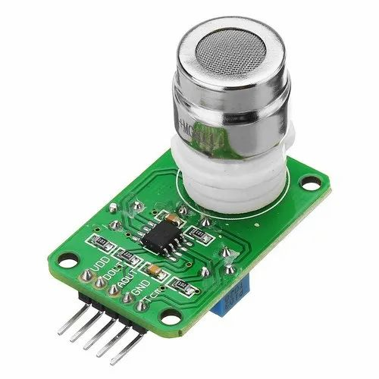
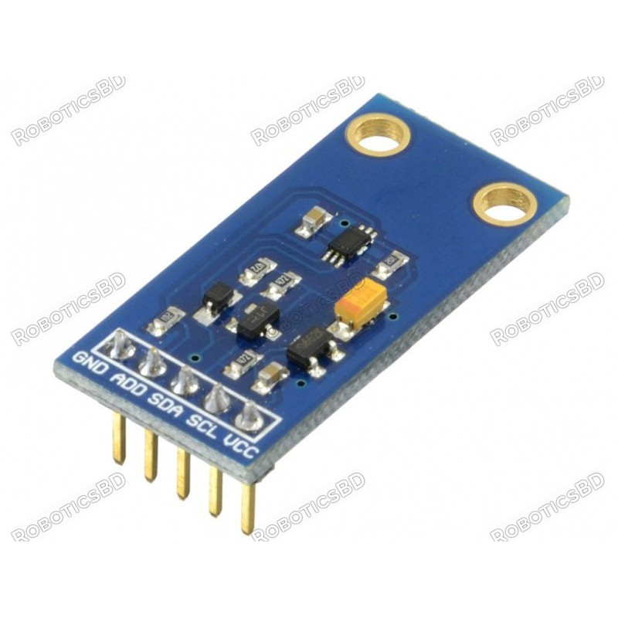
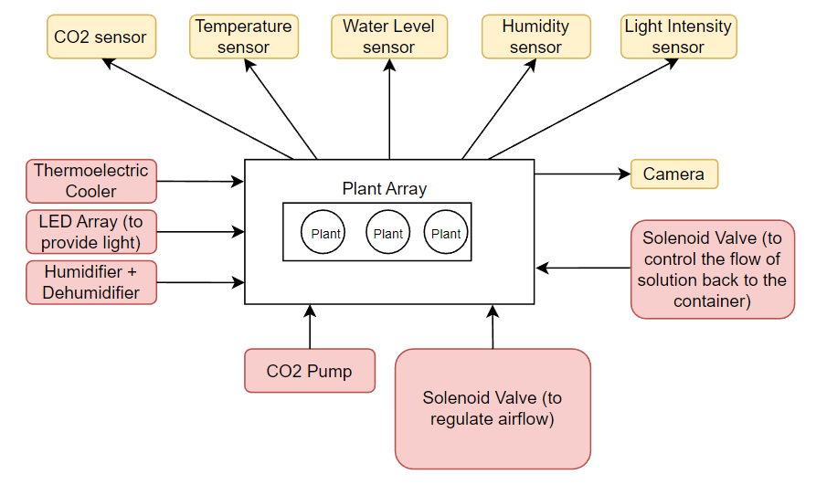
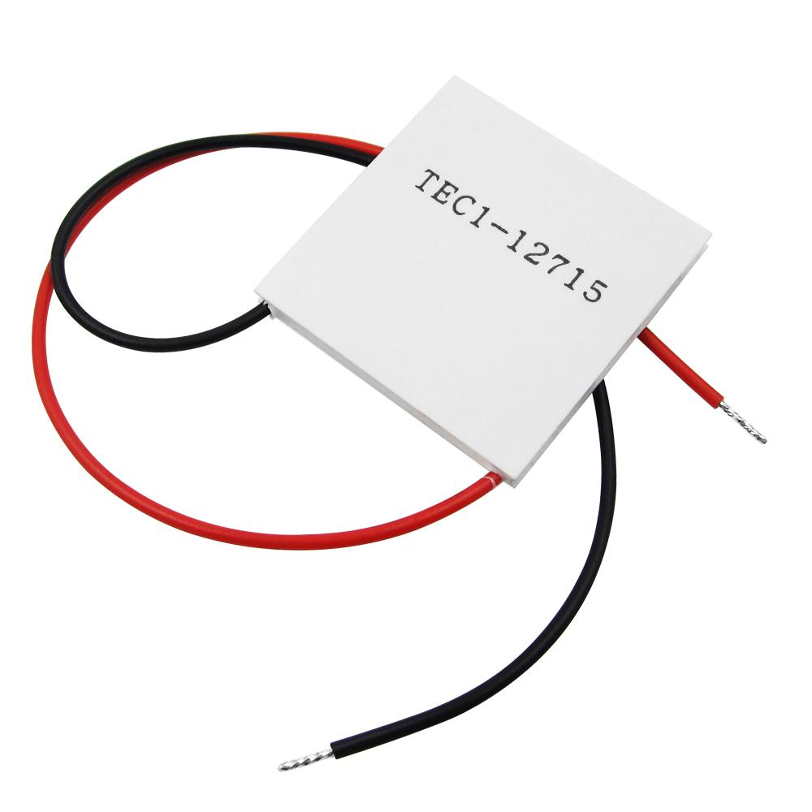
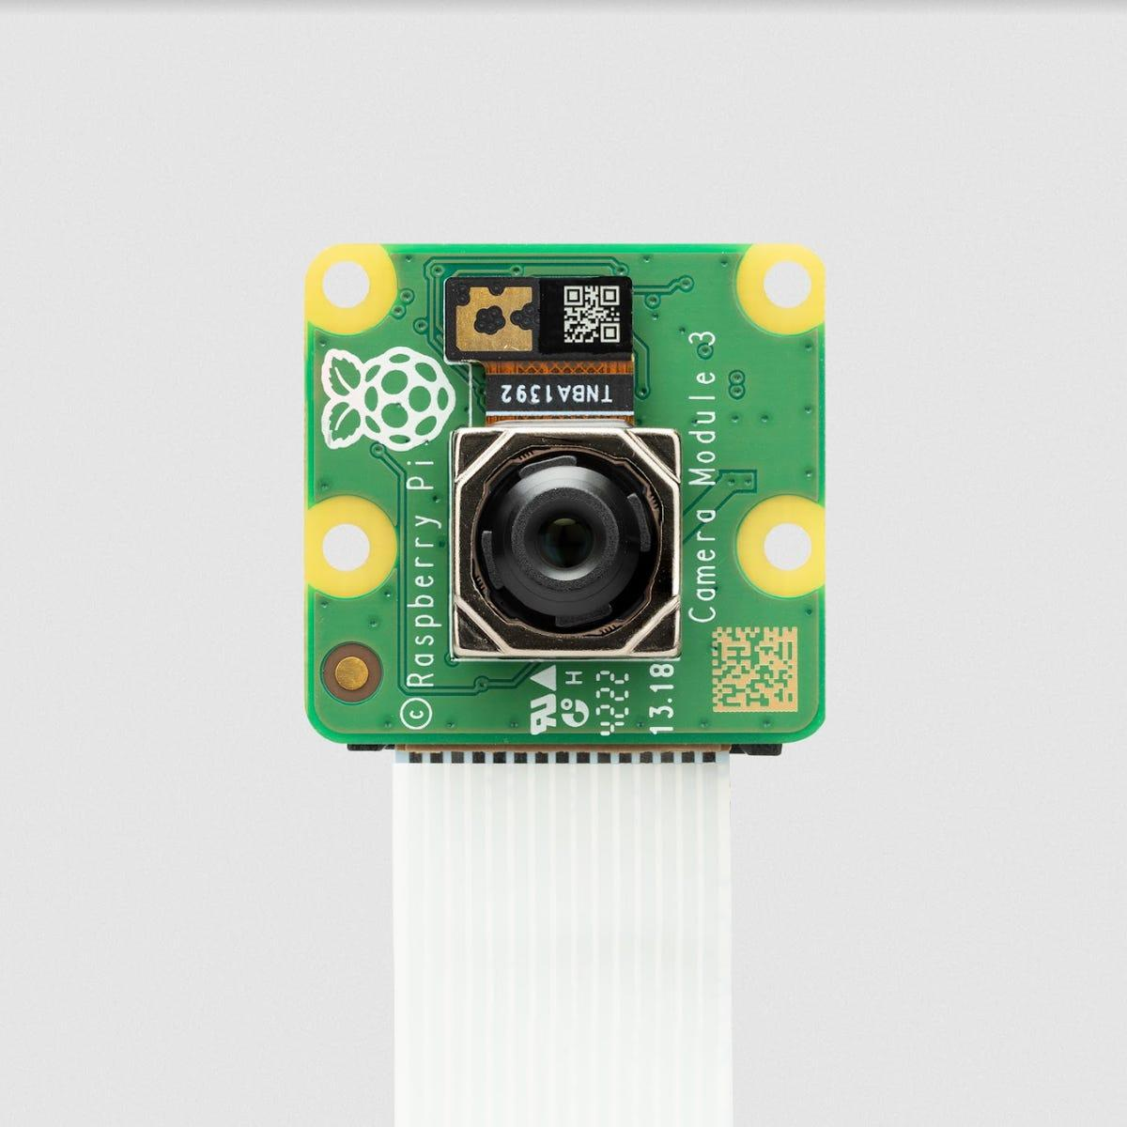
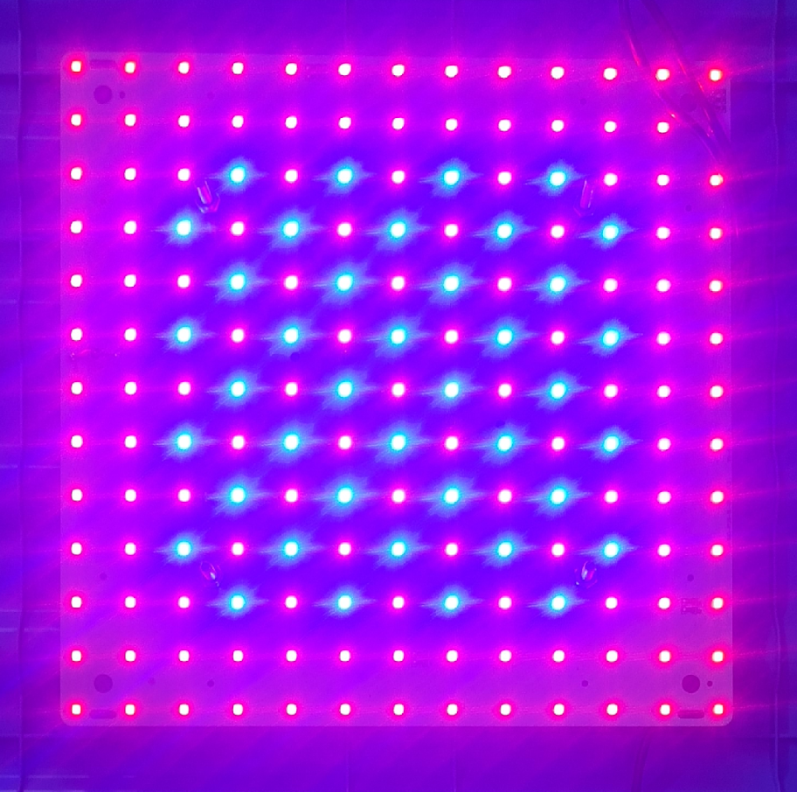
Growth Module
Fig. 3: Block diagram for the Growth Module

Slide 6
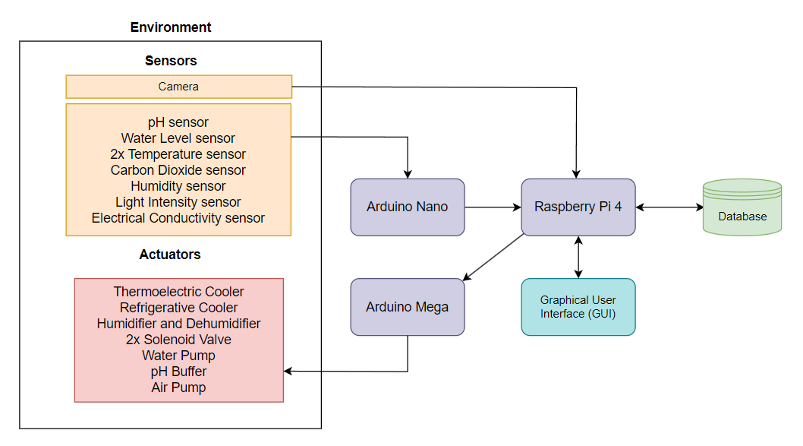
Control System
Fig. 4: Block Diagram illustrating the IoT framework running on the system

Slide 7
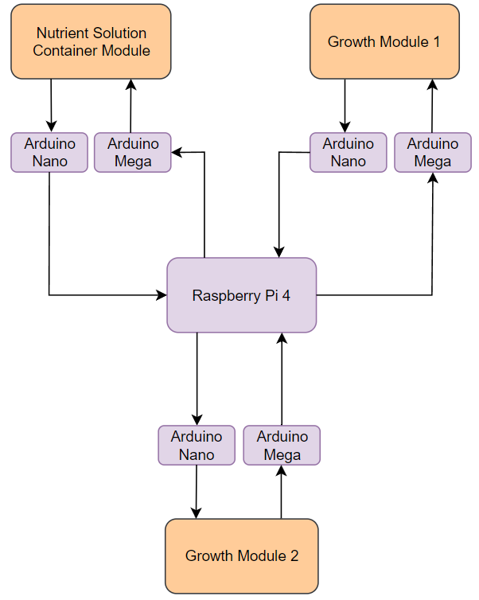
Overview for scaled system
Fig. 5: Block diagram for communication between microcontrollers and the central server

Slide 8
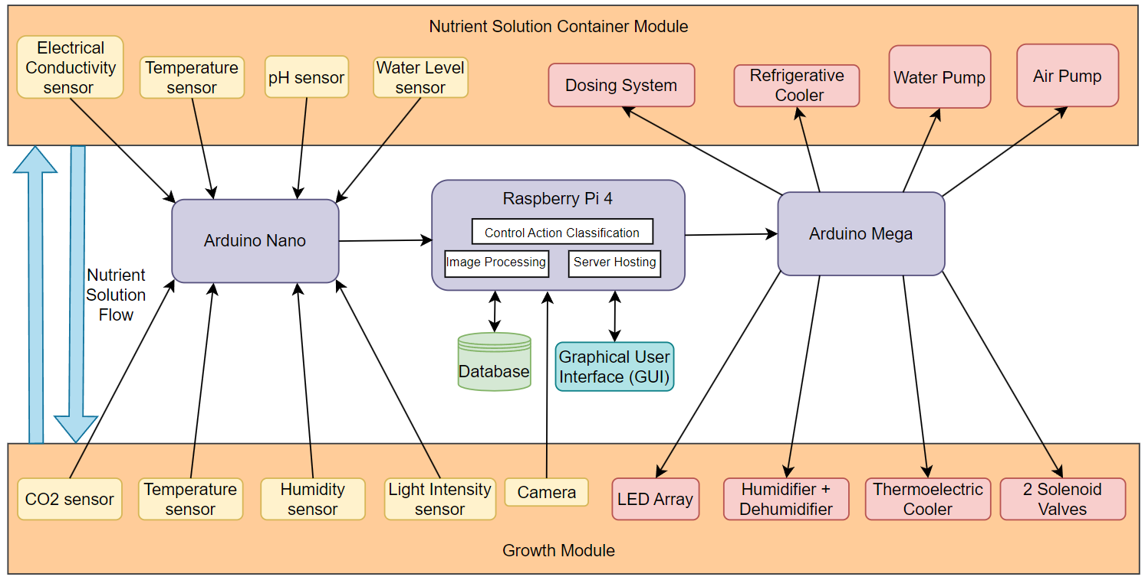
Full System Flow Diagram
Fig. 6: Complete flow diagram of the entire system illustrating the interconnections between all the components

Slide 9
Work Done Thus Far

Slide 10
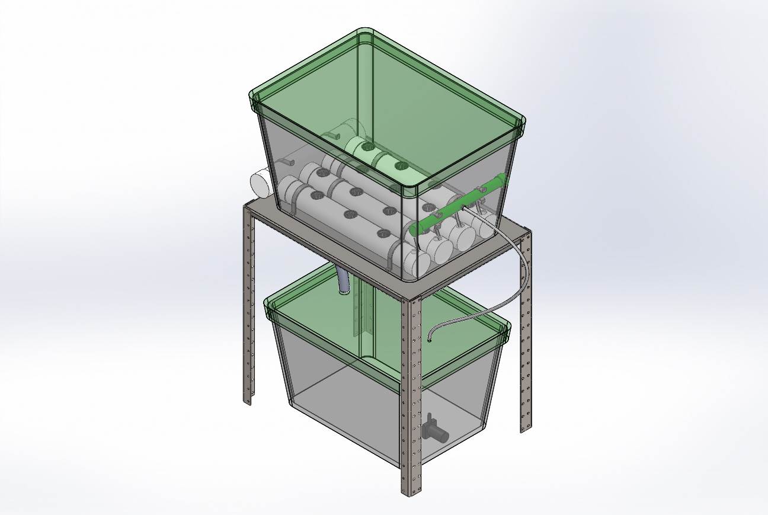
3D CAD Model
Fig. 7: Overhead view of the model.

Slide 11
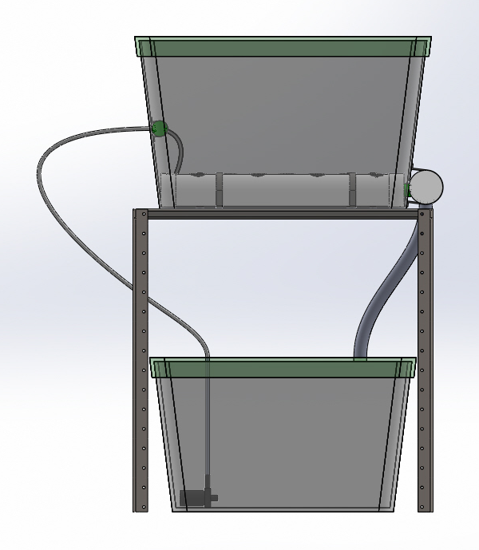
3D CAD Model
½ inch silicone tube
Growth Module
1.25 inch Hose pipe
1.25 inch Hose pipe
Nutrient Solution Container Module
Submersible Water Pump
Fig. 8: Front view of the model.

Slide 12
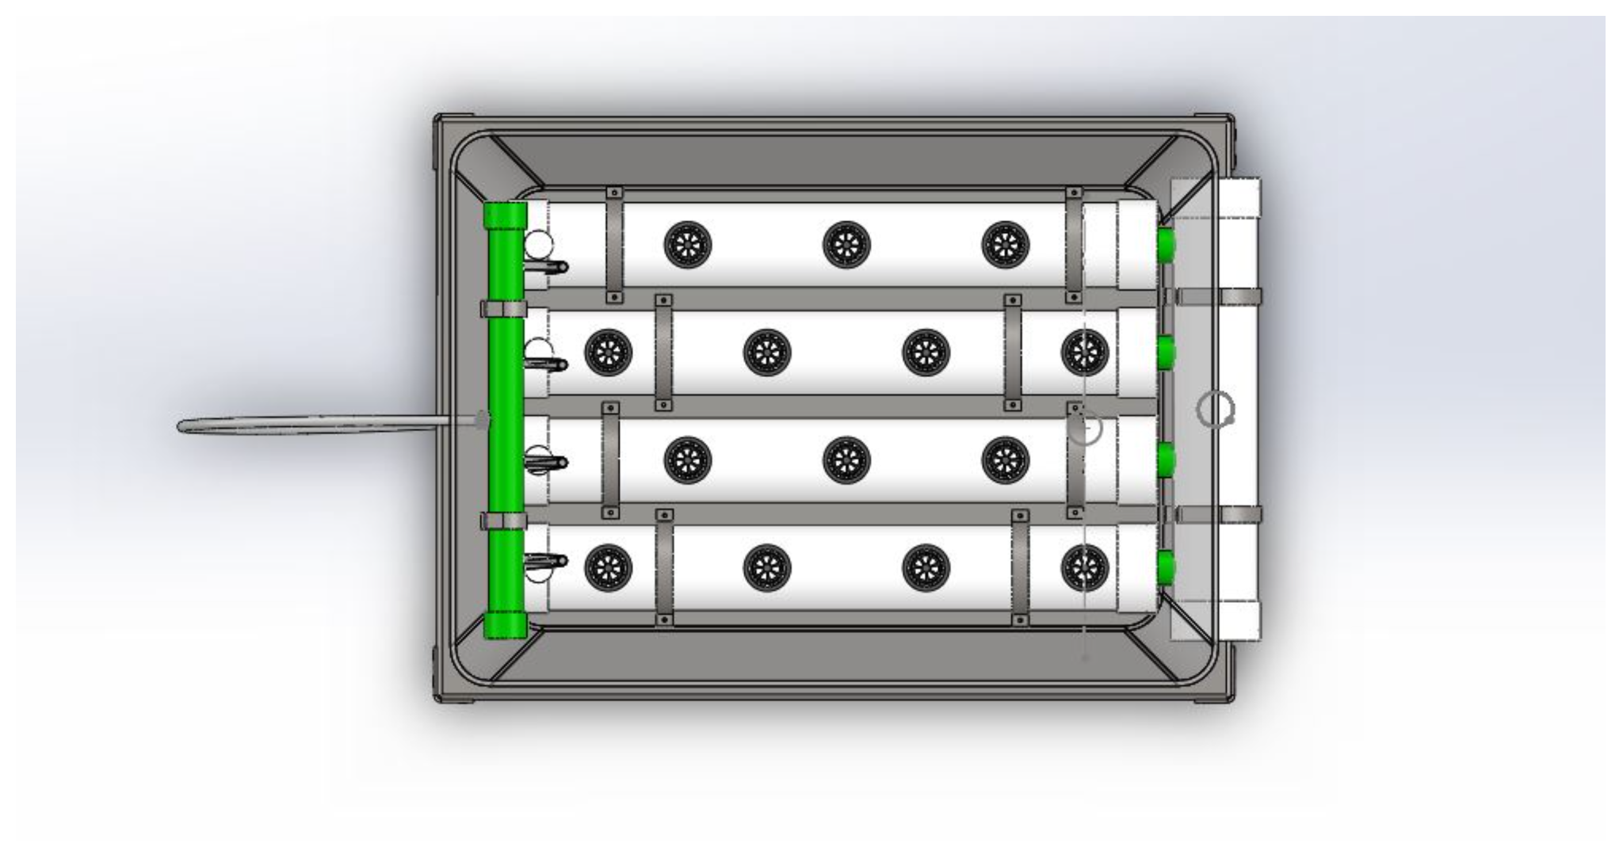
3D CAD Model
3 inch uPVC pipe to house the plants
1 inch uPVC pipe
Net pot
3 inch uPVC pipe to drain nutrient solution
Bracket
Fig. 9: Top view of the model.

Slide 13
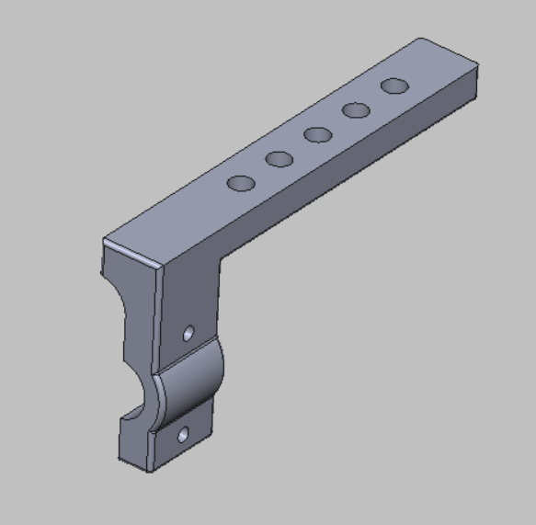
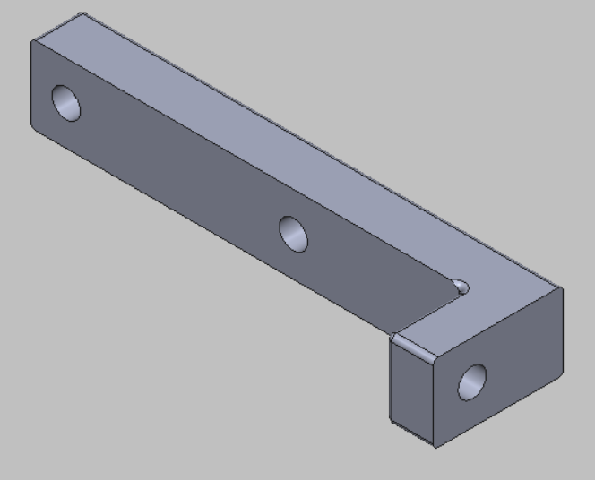
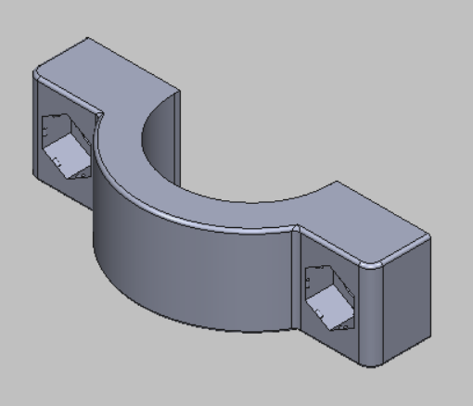
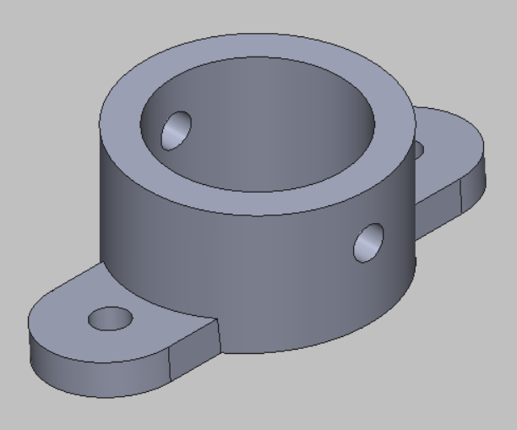
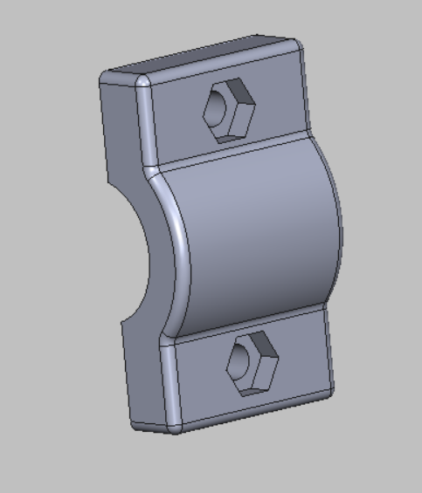
3D CAD Model
Fig. 10: Sensor holder 3D models.

Slide 14
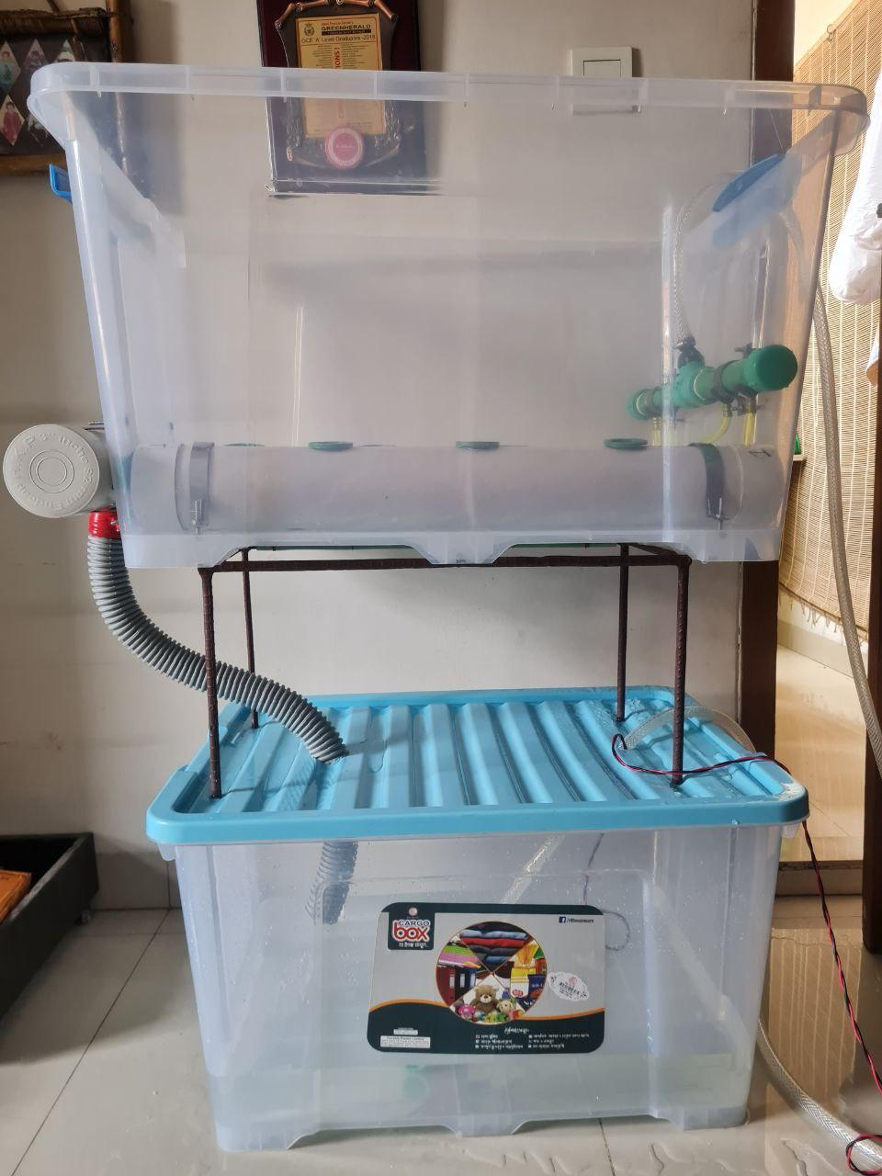
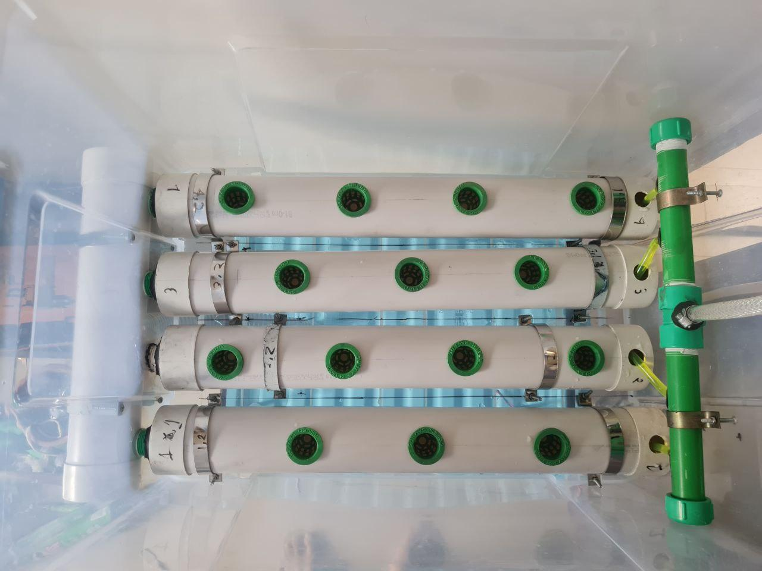
Physical Implementation (Previous)
Fig. 11: Front view of the system
Fig. 12: Top view of the system

Slide 15
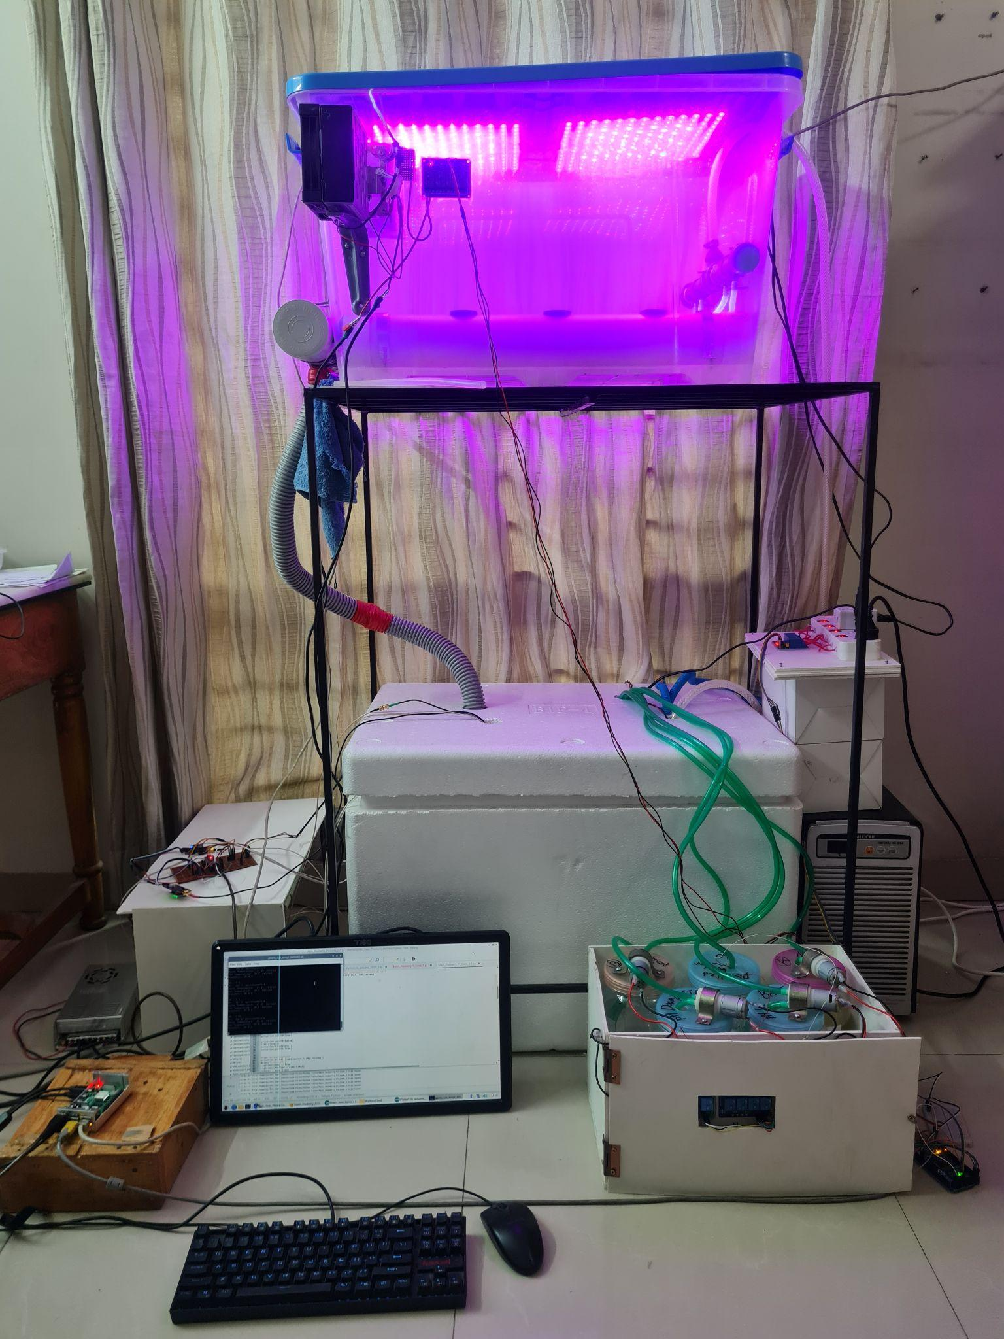
Physical Implementation (Current)
Fig. 13: Front view of the system with Grow Lights turned on

Slide 16
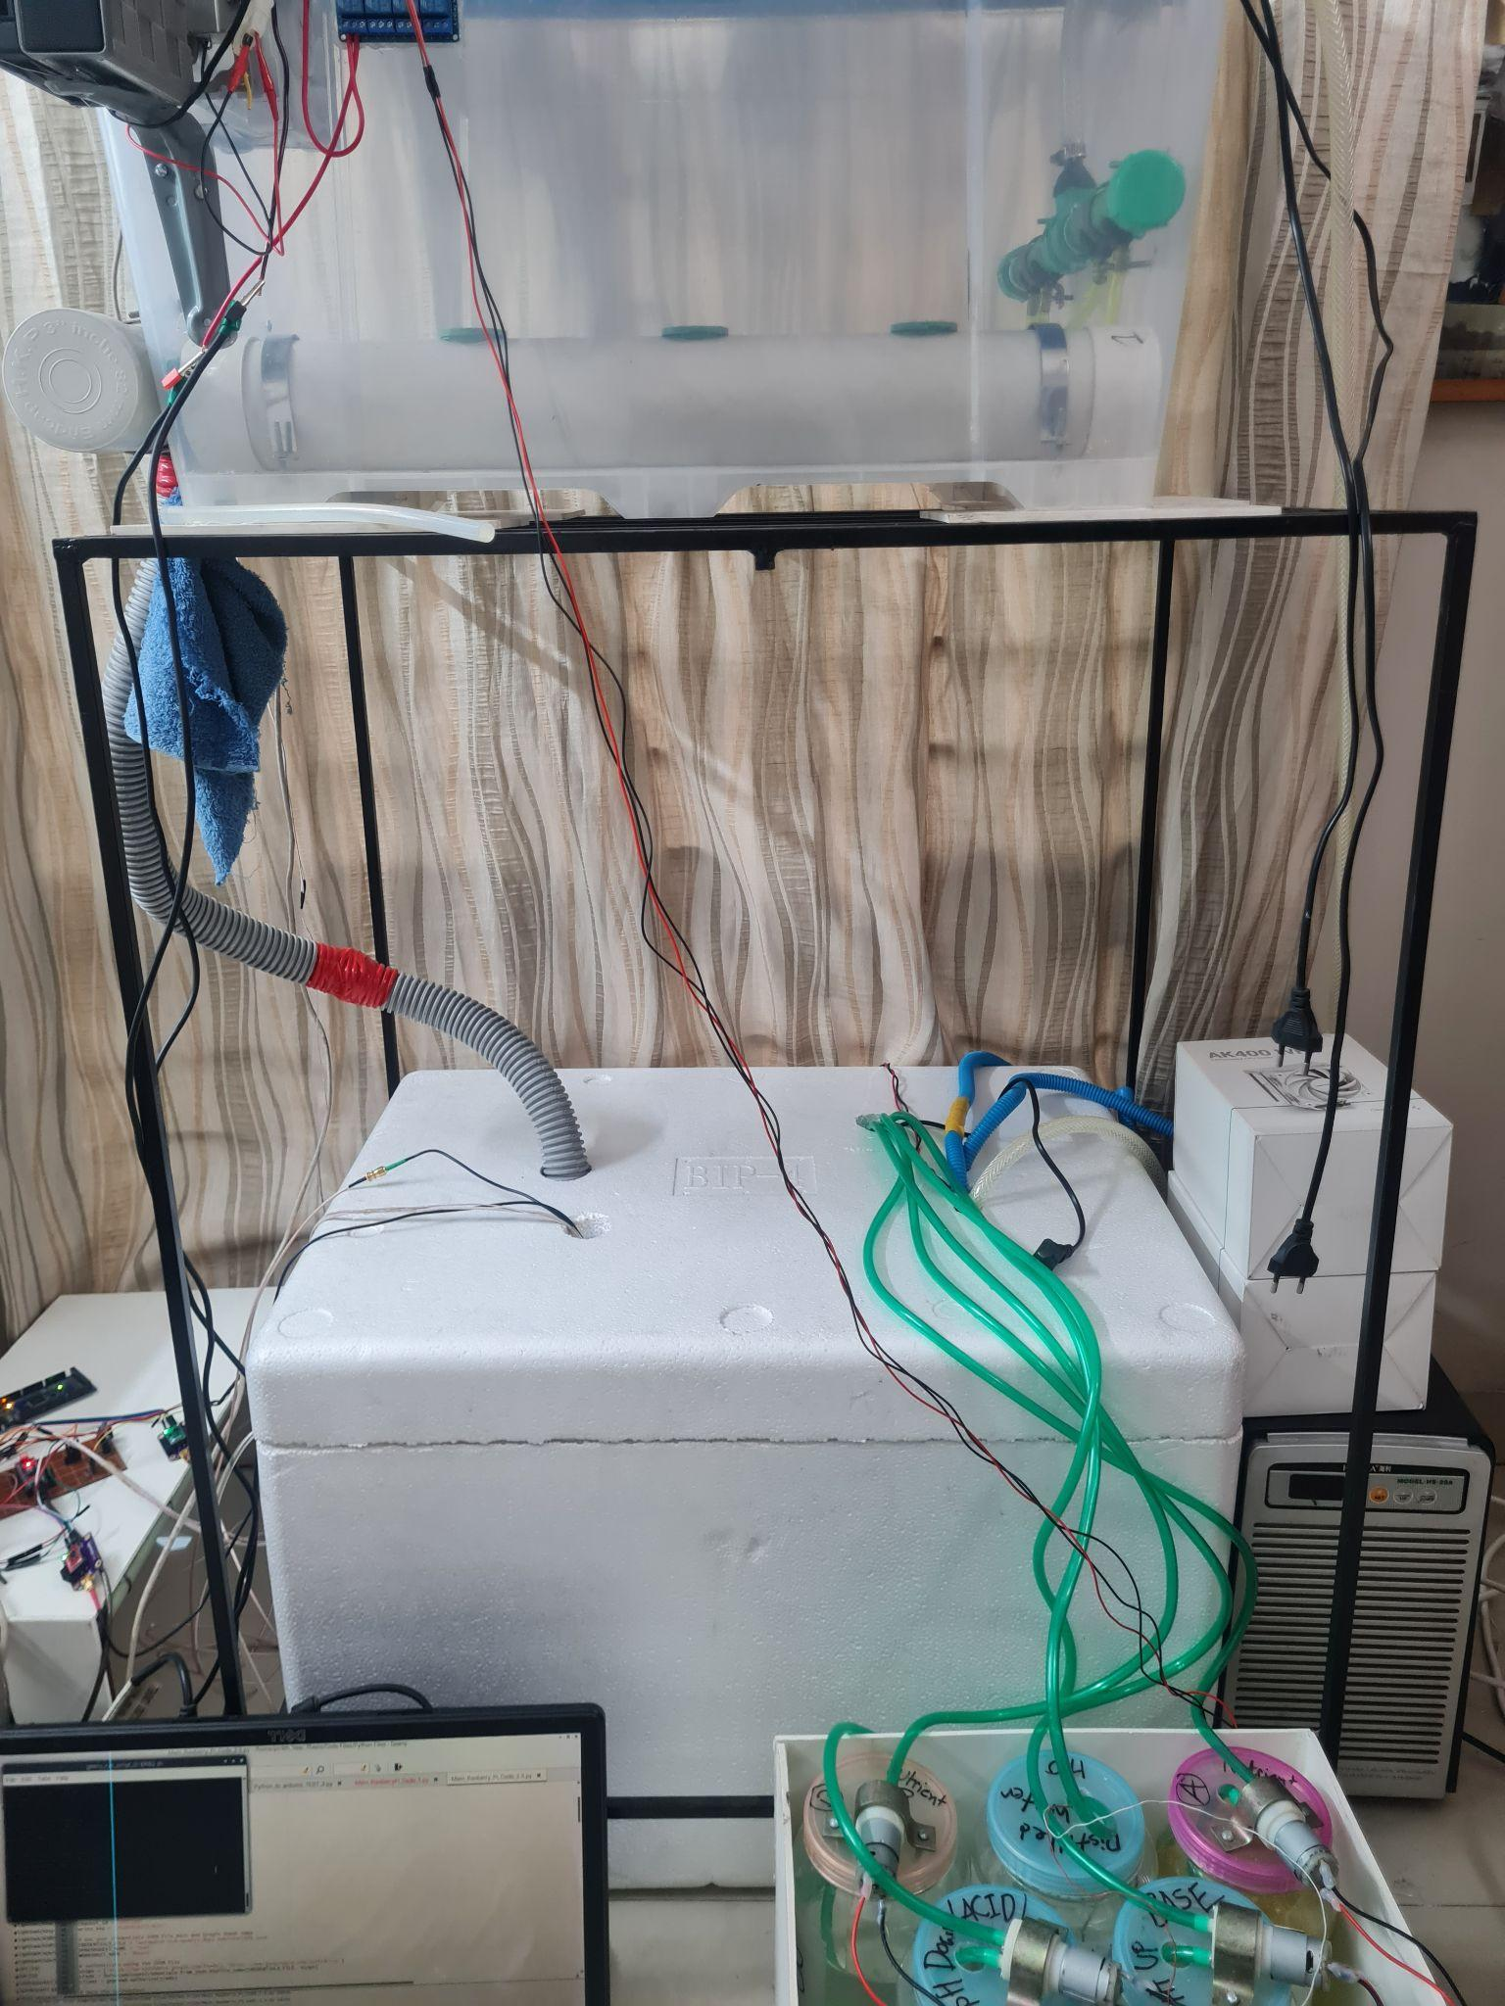
Physical Implementation (Current)
Customized
Metal Frame
Fig. 14: Front view of the system

Slide 17
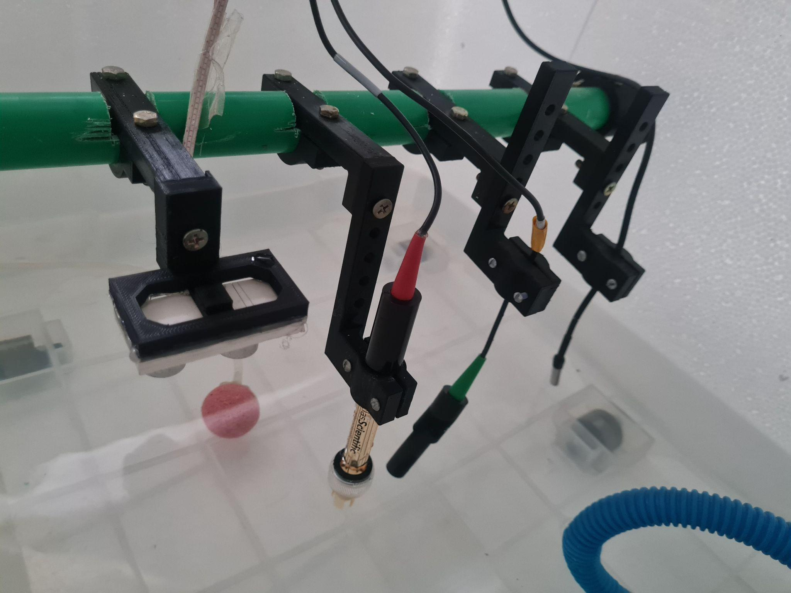
Physical Implementation
Sensor Holders
Temperature
Probe
Ultrasonic
Sensor
pH
Probe
EC Probe
Fig. 15: Ultrasonic sensor, pH probe, EC probe and temperature probe held above the nutrient solution by the sensor holders

Slide 18
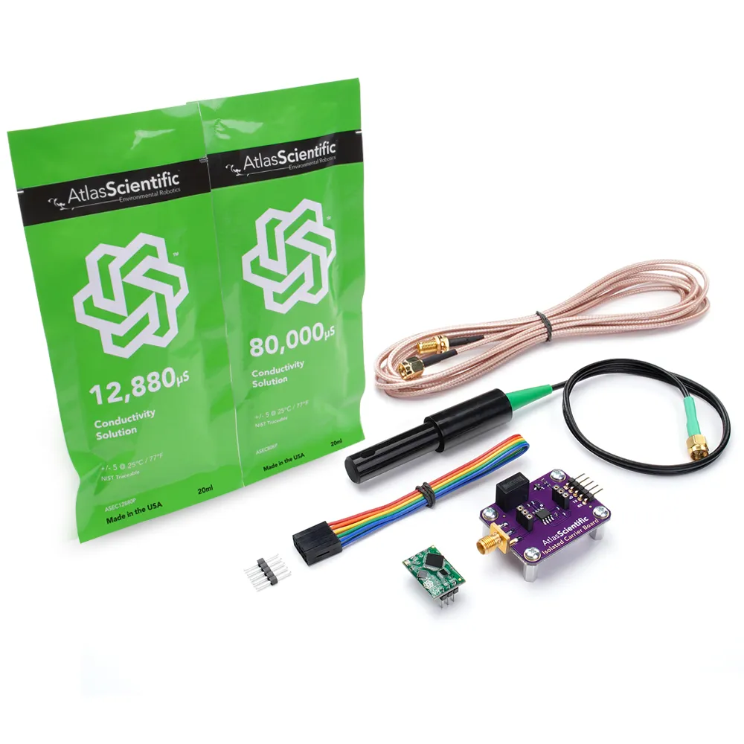
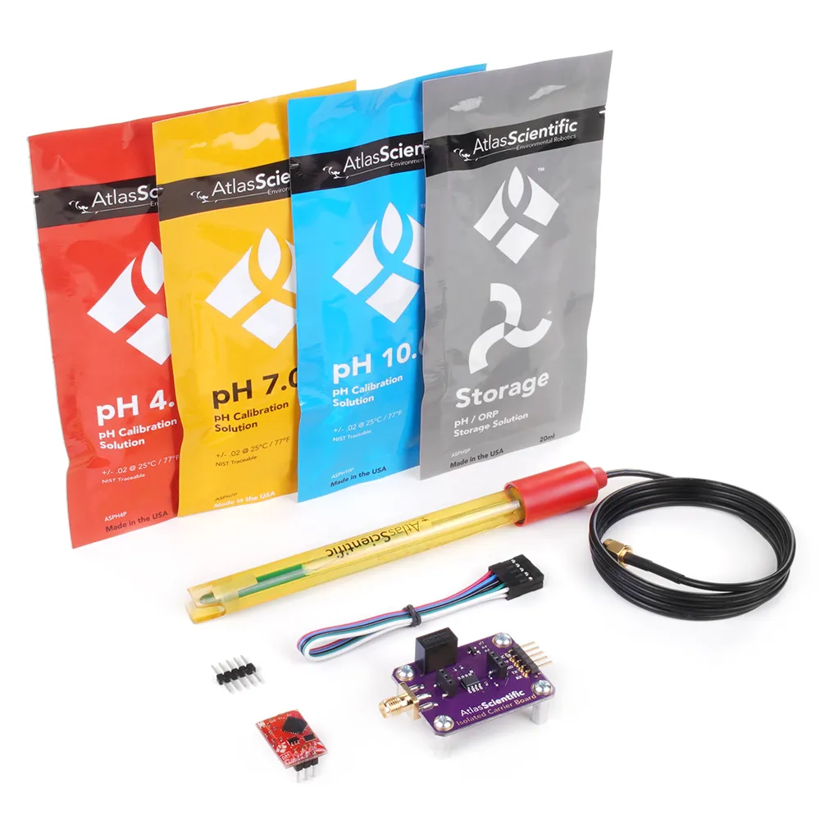
Analog Sensors
Fig. 16: Atlas Scientific pH Kit
Fig. 17: Atlas Scientific Conductivity K 1.0 Kit

Slide 19

Calibrating Sensors (pH sensor)
Fig. 18: Atlas Scientific pH buffer solutions at pH 4.00, 7.00 and 10.00

Slide 20
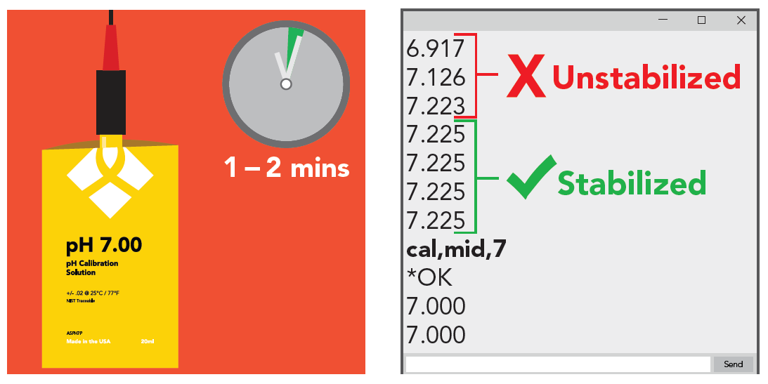
Calibrating Sensors (pH sensor)
Fig. 19: Mid Point Calibration for the pH probe

Slide 21
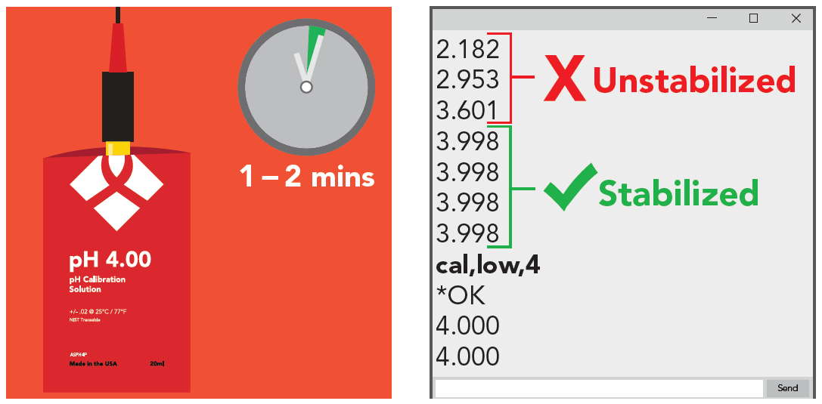
Calibrating Sensors (pH sensor)
Fig. 20: Low Point Calibration for the pH probe

Slide 22
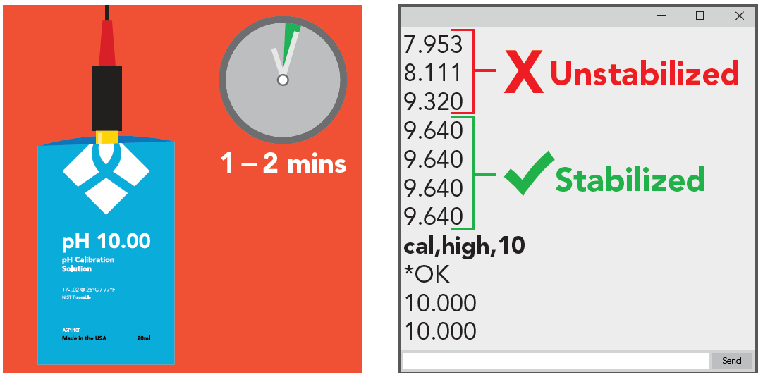
Calibrating Sensors (pH sensor)
Fig. 21: High Point Calibration for the pH probe

Slide 23

Calibrating Sensors (EC sensor)
Fig. 22: Atlas Scientific EC buffer solutions at 12,880 and 80,000 microSemens

Slide 24
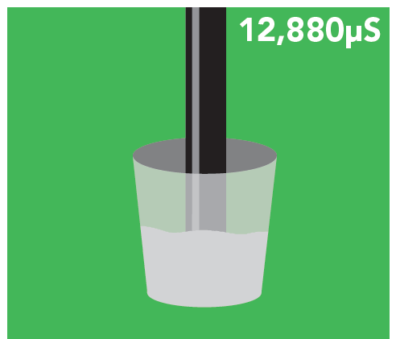
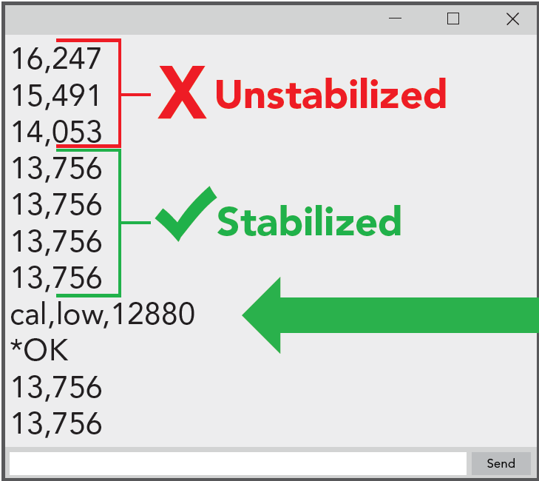
Calibrating Sensors (EC sensor)
Fig. 23: Low Point Calibration for EC probe

Slide 25
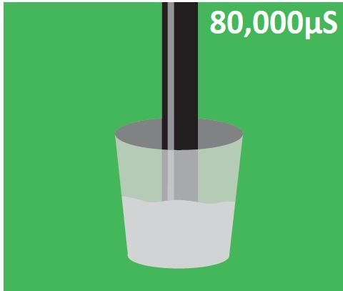
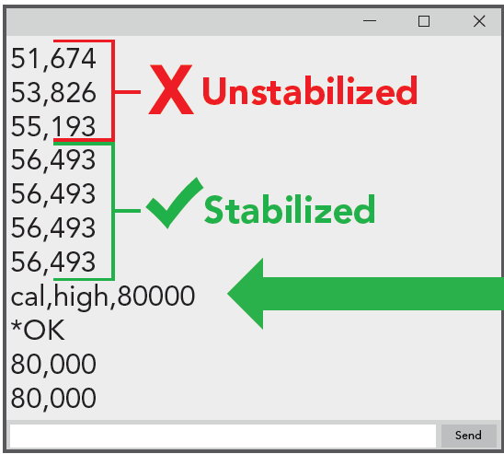
Calibrating Sensors (EC sensor)
Fig. 24: High Point Calibration for EC probe

Slide 26
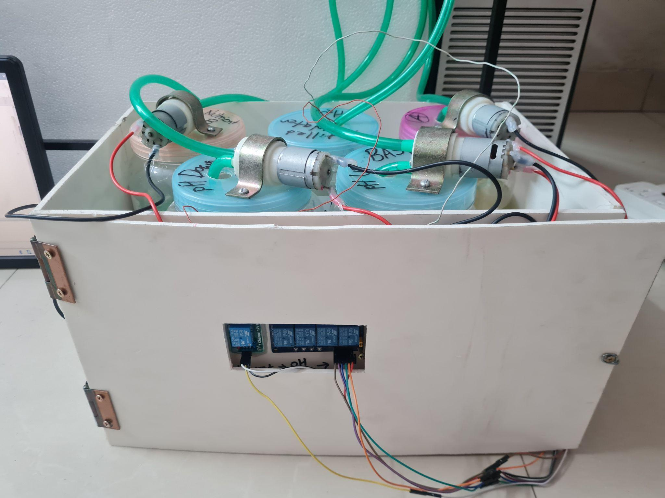
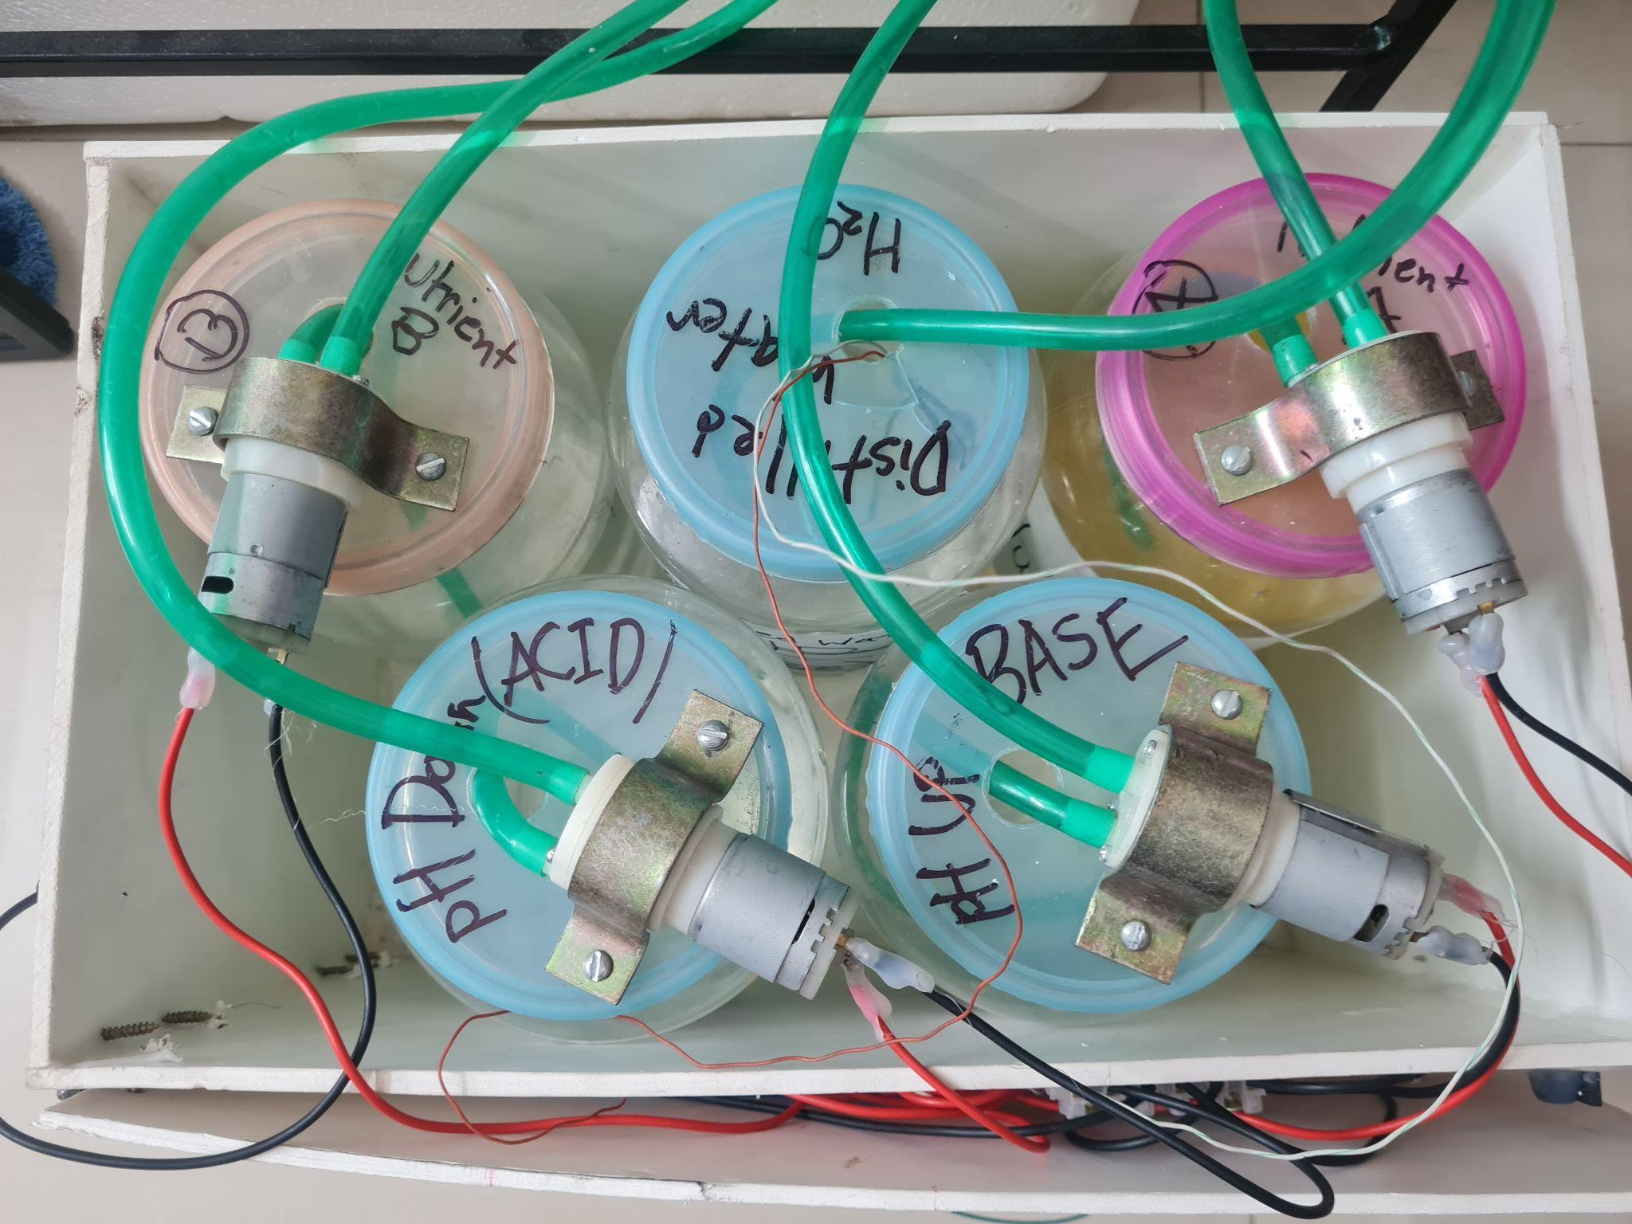
Regulating pH and Nutrient Level (EC) (Current Approach)
Fig. 25: Front View of Acid/Base and Nutrient Dosing System
Fig. 26: Top View of Acid/Base and Nutrient Dosing System

Slide 27
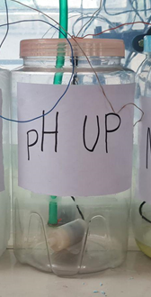
Regulating pH and Nutrient Level (EC) (Previous Approach)
Vaccum Pump
Submersible
Water Pump
Fig. 27: Front View of Old Dosing System
Fig. 28: Top View of the new Acid/Base and Nutrient Dosing System

Slide 28
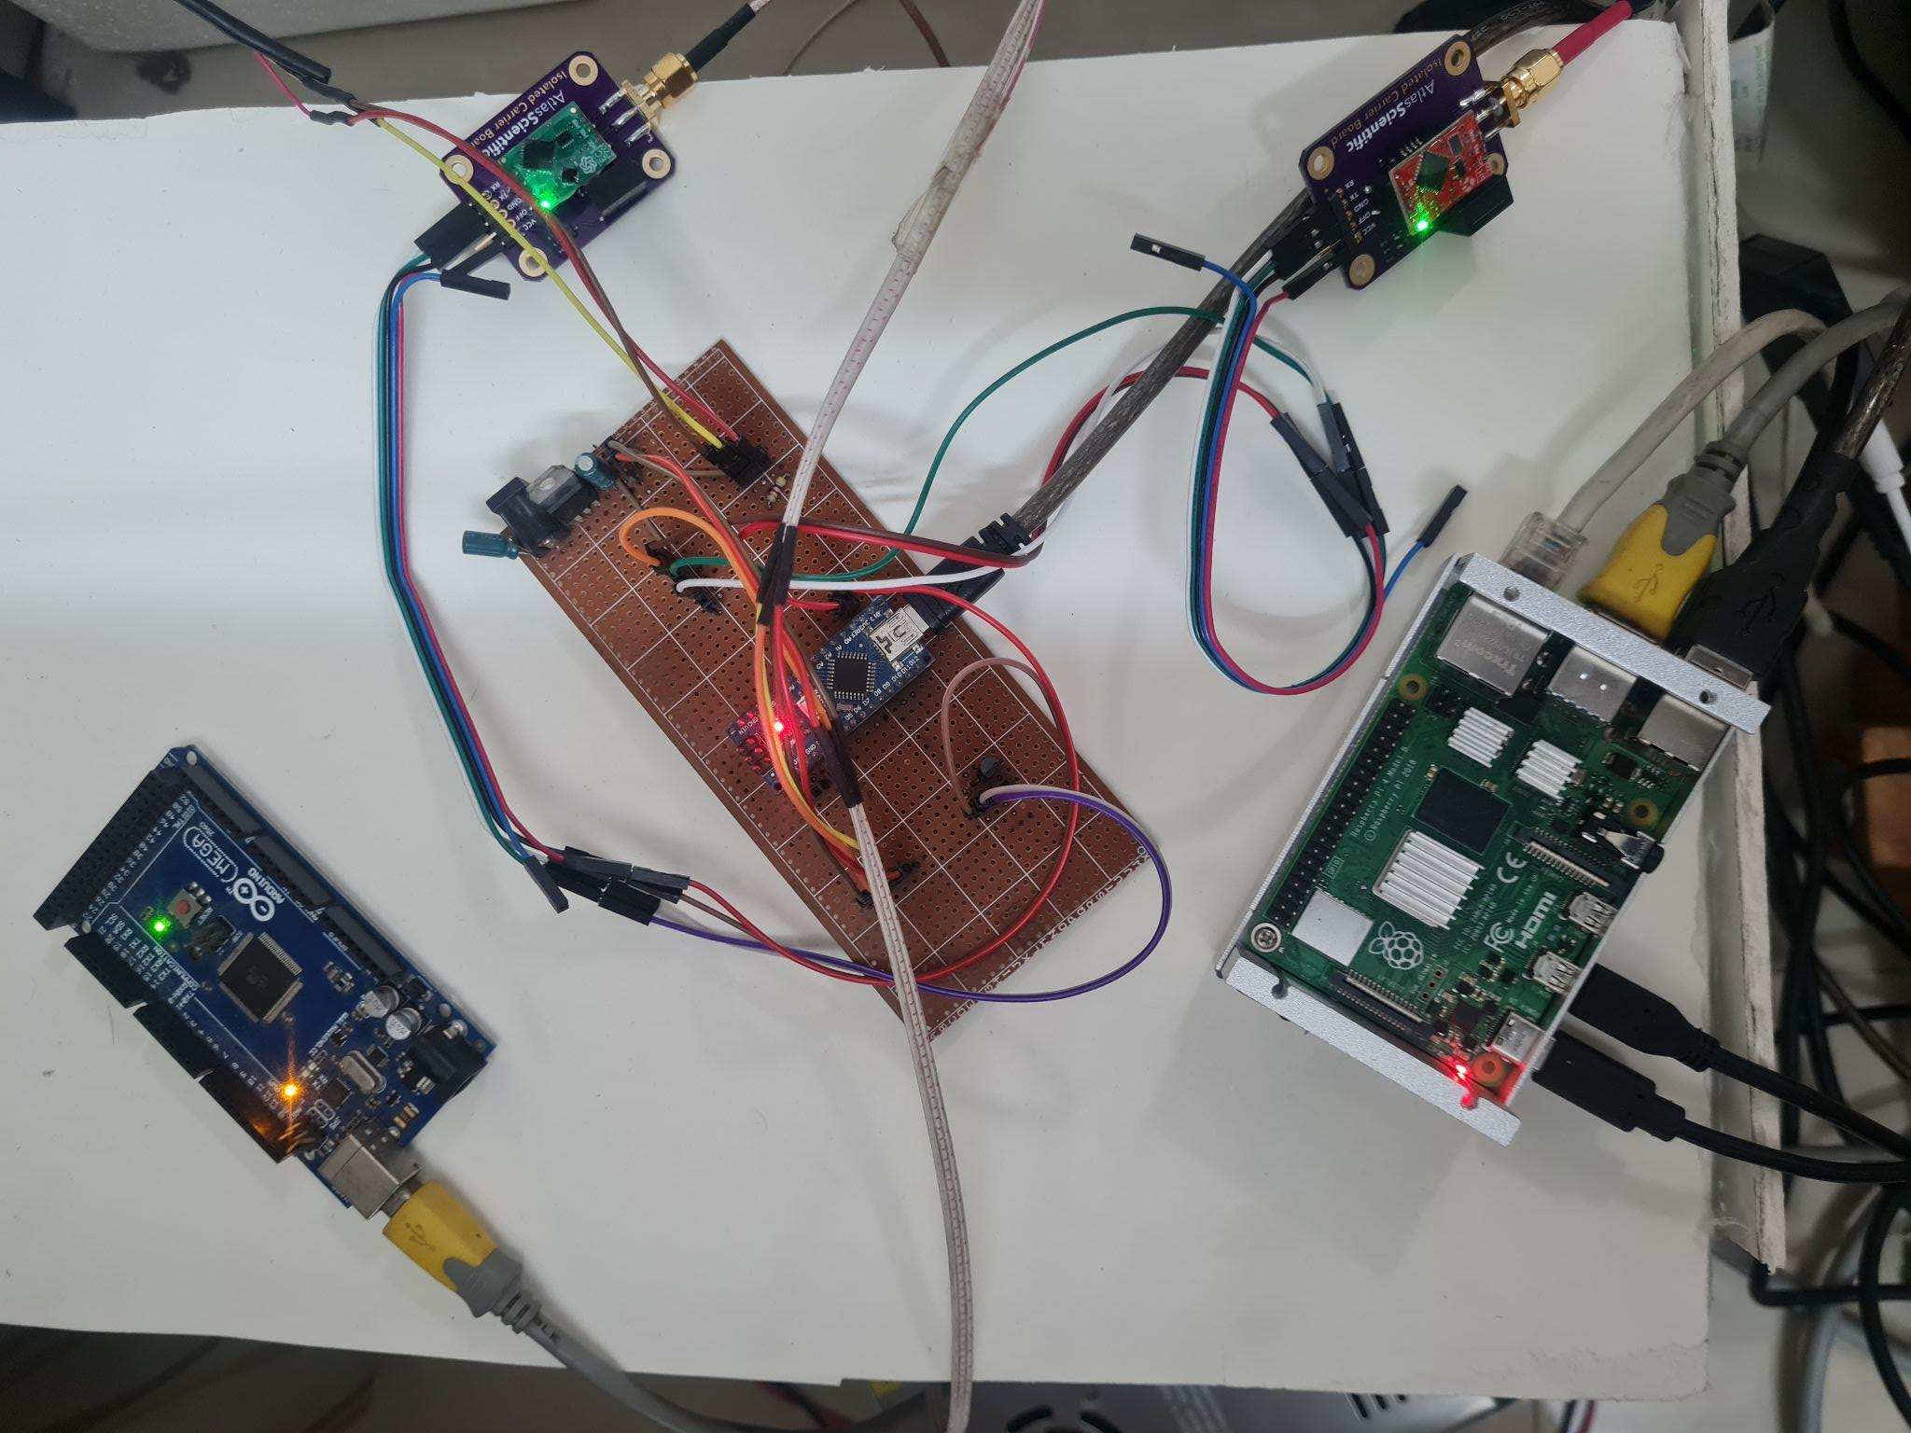
Control Unit
Sensor
Board
Raspberry Pi 4
Arduino Mega for Actuation
Fig. 29: Control Unit showing the connections between the Raspberry Pi, the Arduino Mega and Arduino Nano

Slide 29
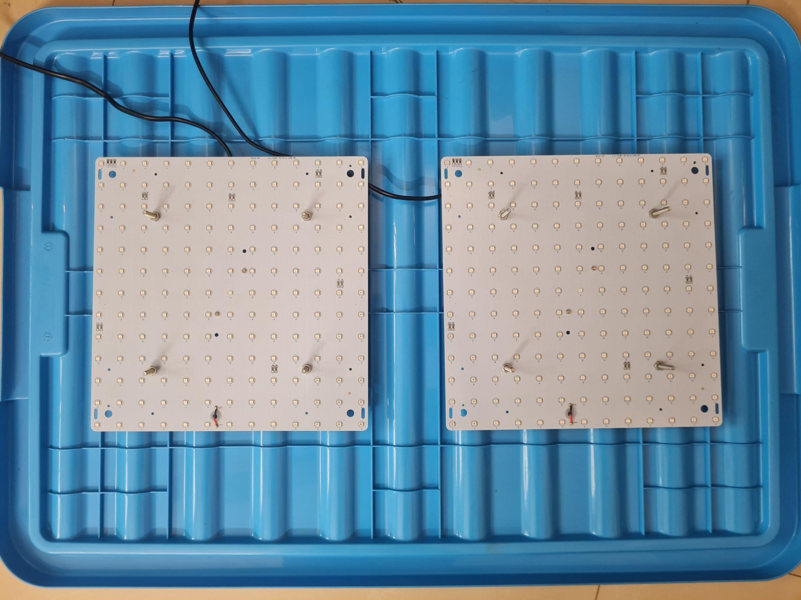
Growth Module
Grow Lights
Fig. 30: Top view of Grow Lights bolted on the underside of the lid

Slide 30
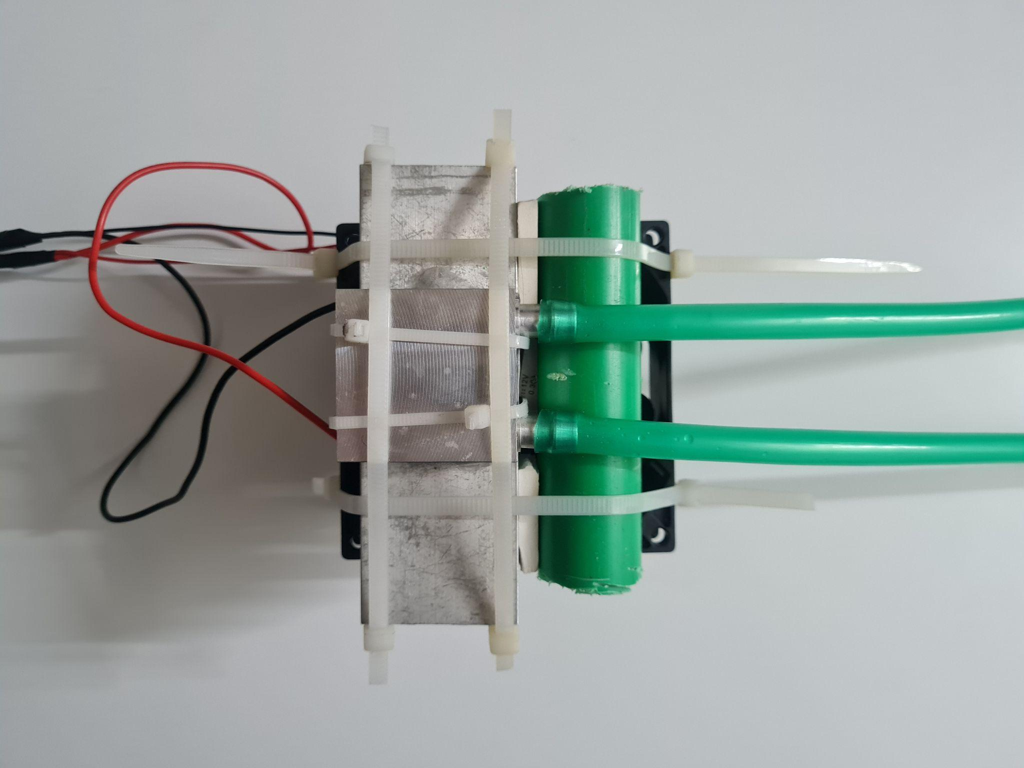
Regulating Water Temperature (Old)
Aluminium Water Block
Peltier Module
Cold Water Flow Out
Warm Water Flow In
Heat Sink
Fig. 31: Top view of Thermoelectric Peltier Module-based Water Cooler
Cooling Fan

Slide 31
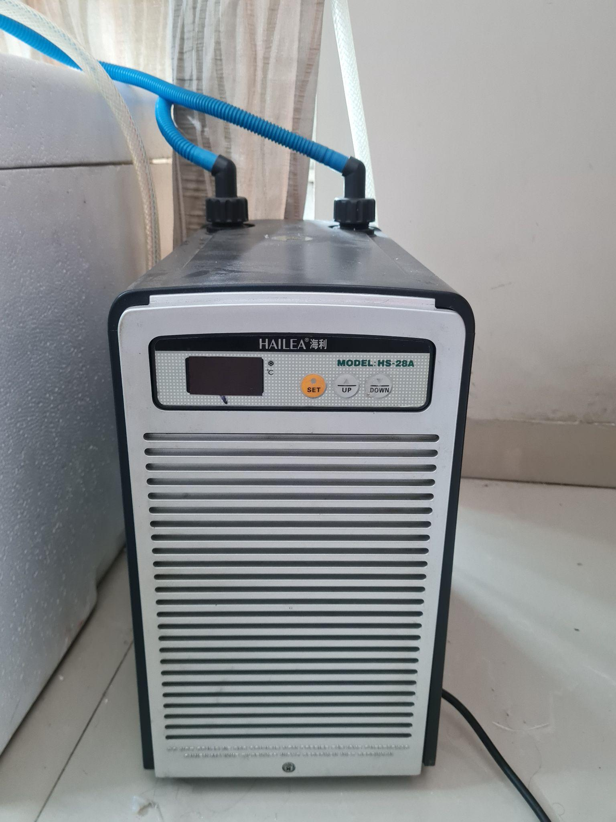
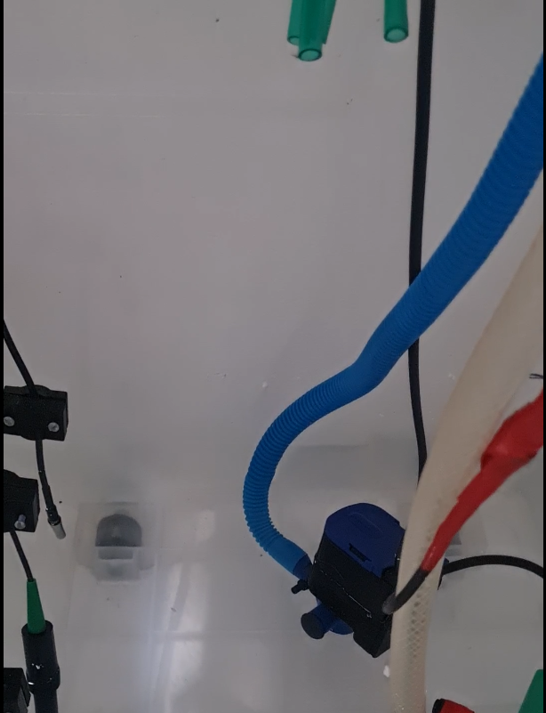
Regulating Water Temperature
Hailea HS-28A
Aquarium Chiller
Water Pump
For Chiller
Fig. 32: Hailea HS-28A Aquarium Chiller
Fig. 33: Water Pump for Chiller

Slide 32
Regulating Water Temperature
Fig. 34: Concede Box Containing the Nutrient Container Module

Slide 33


Regulating Air Temperature
CPU Cooler
Connector
Board
Peltier Module
Fig. 35.1: Isometric view of Air Cooling System
Fig. 35.2: Top view of Air Cooling System

Slide 34

Automated AC Power Supply
Grow Lights
Water Chiller
Water Pump for Chiller
Fig. 36: Automated Multiplug using a 4-channel 12V relay

Slide 35

DC Power Supply
Peltier Module
Connection
Fig 37: Switched-Mode Power Supply (SMPS) 12V - 30A Power Supply

Slide 36


Monitoring Sensor Reading
Fig. 38: Web-based dashboard showing the visualizations from ThingSpeak from sensor data logged by the Raspberry Pi
Fig. 39: Web-based dashboard showing the widgets from ThingSpeak from sensor data logged by the Raspberry Pi

Slide 37

Collecting Data
Fig. 40: Sensor data logged by the Raspberry Pi being stored in Google Sheets

Slide 38

Physical Implementation
Fig. 41: Temperature and Humidity Sensor (DHT22) in the Growth Module

Slide 39


Sensor Reading
Fig. 42.1: Top view of the sensor board
Fig. 42.2: Bottom view of the sensor board

Slide 40

Sensor Reading
Fig. 43: Schematic for the sensor board, designed in Proteus 8 Professional

Slide 41


Analog Sensors
Fig. 44: pH Sensor
Fig. 45: EC Sensor

Slide 42


Calibrating Sensors (pH sensor)
Fig. 46: pH buffer solutions
Fig. 47: Scatterplot of pH against electrode voltage graph

Slide 43


Calibrating Sensors (EC sensor)
Fig. 48: TDS buffer solution
Fig. 49: Scatterplot of EC against electrode voltage graph

Slide 44

Regulating pH and Nutrient Level (EC)
Fig. 50: Acid/Base and Nutrient Dosing System

Slide 45

Regulating Water Temperature
Aluminium Water Block
Peltier Module
Cold Water Flow Out
Warm Water Flow In
Heat Sink
Fig. 51: Top view of Thermoelectric Peltier Module-based Water Cooler
Fig. 52: Side view of Thermoelectric Peltier Module-based Water Cooler
Cooling Fan

Slide 46

Decision Making Flowchart
Fig. 53: Flowchart of sensor system.

Slide 56

Our System Thus Far
Fig. 54: Front view of our system

Slide 57
Experimental Demonstration of the System

Slide 58
Results

Slide 59


Result (Testing the pH sensor)
Fig. 55: Serial Monitor readings from testing the pH sensor
Fig. 56: pH 6.86 buffer solution

Slide 60


Result (Testing the EC sensor)
Fig. 57: Serial Monitor readings from testing the EC sensor
Fig. 58: EC buffer solution of 1413 micro-siemens/cm

Slide 61

Initial Data from the System
Fig. 59: Visualizations from the sensor data collected by the Raspberry Pi at system startup

Slide 62
Initial Data from the System
Fig. 60: Updated Values from the sensor data collected by the Raspberry Pi at system startup

Slide 63
Data from the System after an interval
Fig. 61: Visualizations from the sensor data collected by the system after a time interval

Slide 64

Data from the System after an interval
Fig. 62: Update Values from the sensor data collected by the Raspberry Pi after a time interval

Slide 65
Google Sheet Spreadsheet updates
Fig. 63: The Google Sheet spreadsheet showing the sensor data logged by the Raspberry Pi since system startup

Slide 66


Result
Fig. 64: Serial Monitor readings from testing the sensors.
Table 1: Serial Monitor readings from testing the sensors.

Slide 67
Expected Work To Be Done

Slide 68




Fig. 65: Total expenditure thus far behind the system

Slide 69
Economic Viability

Slide 70

Fixed Costs for the Modules
Fig. 66: Fixed costs behind the components used in each module

Slide 71

Average Cost over time with 1 Growth Module
Fig. 67: Average cost vs Production cycle graph using 1 Growth Module

Slide 72

Average Cost over time with 2 Growth Modules
Fig. 68: Average cost vs Production cycle graph using 2 Growth Module

Slide 73

Average Cost over time with 4 Growth Module
Fig. 69: Average cost vs Production cycle graph using 4 Growth Module

Slide 74
Expected Work To Be Done

Slide 75
Expected Work To Be Done
Adding CO2 cylinders to Growth Module (GM) as a CO2 source
Growing a batch of lettuce to test the system
Implementing an Xgboost-based decision-making system
Developing and controlling multiple Growth Modules (GMs) simultaneously

Slide 76
Project Timeline
1st Mid Defense
Designing and developing the basic physical system
1st Final Defense
Adding automation to the Nutrient Solution Container Module
2nd Mid Defense
Adding CO2 cylinders to Growth Module (GM) as a CO2 source and growing a batch of lettuce to test the system
Implementing an Xgboost-based decision-making system
2nd Final Defense
Controlling multiple Growth Modules (GMs) simultaneously
Fig. 70: Timeline for the different stages of the project

Slide 77
Conclusion

Slide 78
Conclusion
This system will enable us to grow crops which would otherwise not grow in Bangladesh.
It will allow us to grow plants much faster than conventional soil-based farming.
Produce from this system will be free of pesticides and thus much healthier.
Our system will control more parameters than previous works
Thus far, we have implemented automation to monitor the pH, EC and water temperature.
We plan on implementing further automation and adding IoT to the system to monitor its status remotely.
We plan on developing a decision making system based on XGboost.

Slide 79
References
[1] Gericke, William F. (1937). "Hydroponics - crop production in liquid culture media". Science. 85 (2198): 177– 178. [2] Macrovector, Hydroponics Farming Concept,[Online], Available: https://www.vectorstock.com/royalty-free-vector/hydroponics-farming-concept-vector-27183466 [3] iStock, Young seedling of vegetable grows in fertile soi sprout with underground rootl, [Online], Available: https://www.istockphoto.com/vector/young-seedling-of-vegetable-grows-in-fertile-soil-sprout-with-underground-root-gm1213143822-352438337 [4] iStock, Hydroponics plants vector isolated illustration, [Online], Available: https://www.istockphoto.com/vector/hydroponics-plants-vector-isolated-illustration-gm968421950-264048421 [5] Freepik, Hydroponics benefits concept with water saving fast growth symbols, [Online], Available: https://www.freepik.com/premium-vector/hydroponics-benefits-concept-with-water-saving-fast-growth-symbols-cartoon_13768284.html [6] Lineham, Verity, Sally Thorpe, Neil Andrews, Yeon Kim, and Farah Beaini. Food Demand to 2050: Opportunities for Australian Agriculture, Algebraic Description of Agrifood Model. ABARES, 2012. [7] Palande, Vaibhav, Adam Zaheer, and Kiran George. "Fully automated hydroponic system for indoor plant growth." Procedia Computer Science 129 (2018): 482-488. [8] D. Adidrana and N. Surantha, "Hydroponic Nutrient Control System based on Internet of Things and K-Nearest Neighbors," 2019 International Conference on Computer, Control, Informatics and its Applications (IC3INA), Tangerang, Indonesia, 2019, pp. 166-171, doi: 10.1109/IC3INA48034.2019.8949585. [9] Kularbphettong, Kunyanuth, Udomlux Ampant, and Nutthaphol Kongrodj. "An automated hydroponics system based on mobile application." International Journal of Information and Education Technology 9.8 (2019): 548-552. [10] M. Mehra, S. Saxena, S. Sankaranarayanan, R. J. Tom, and M. Veeramanikan- dan, “Iot based hydroponics system using deep neural networks,” Computers and electronics in agriculture, vol. 155, pp. 473–486, 2018. [11] D. S. Domingues, H. W. Takahashi, C. A. Camara, and S. L. Nixdorf, “Automated system developed to control ph and concentration of nutrient solution evaluated in hydroponic lettuce production,” Computers and electronics in agriculture, vol. 84, pp. 53–61, 2012. [12] C. S. Dr. Melissa Brechner, Dr. A.J. Both, Hydroponic Lettuce Handbook. New York, USA: Cornell University Controlled Environment Agriculture Program, 2013.

Slide 80
Thank You

